Slide 1
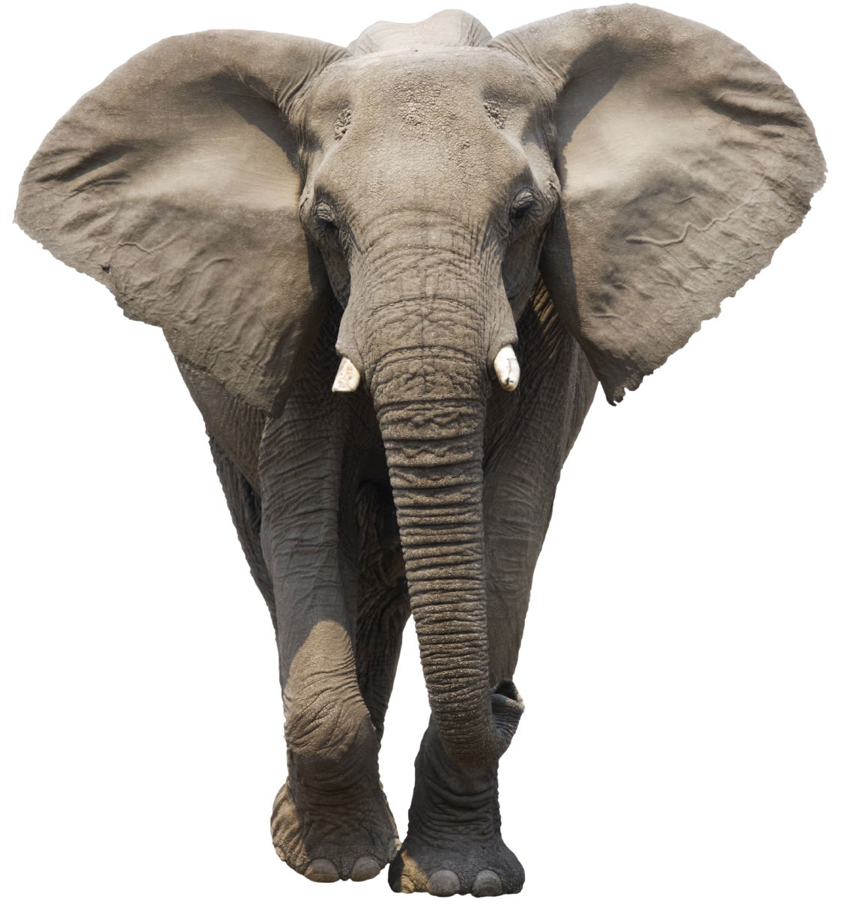
JamesSPILLANE
HealthIQ
Notes:
What is the first thing you think of when you think of design?

Slide 2
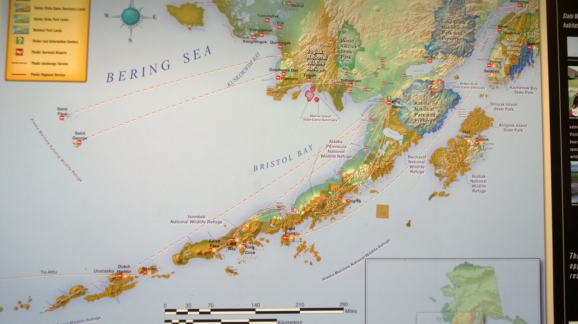
Notes:
What is the first thing you think of when you think of design?

Slide 3
What is Design?
Notes:
What is the first thing you think of when you think of design?

Slide 4
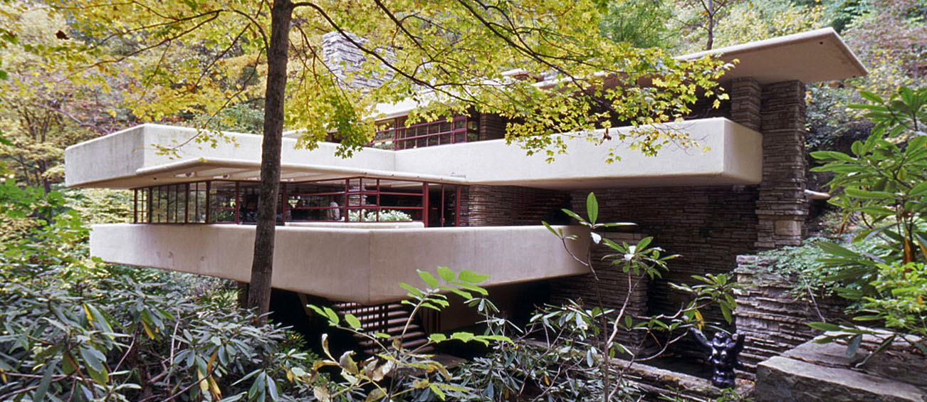
Notes:
What we think of when we think of Design?
Design thinking is the essential ability to combine EMPATHY creativity and rationality to meet the users needs and drive your own success. WIN WIN

Slide 5
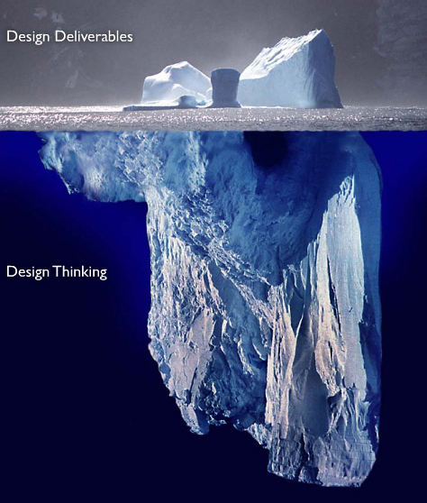
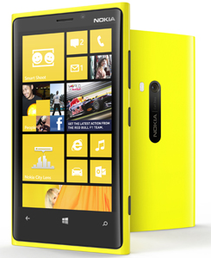
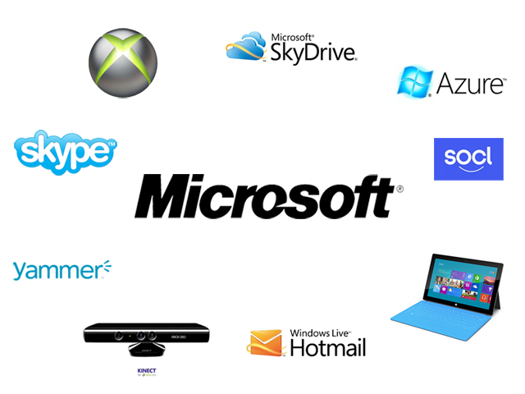
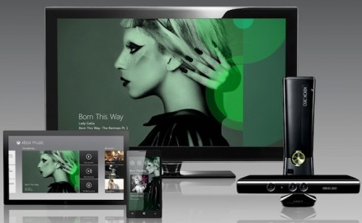
Notes:
What it really is….
we see a product and think, this looks pretty…
Design thinking is the whole entire ecosystem and how we interact through out it, how we interface with it.
Up intil we haven’t been successful because we are looking at things singularly, now how they interact with humans

Slide 6
Are there humans involved in anything you do?

Slide 7
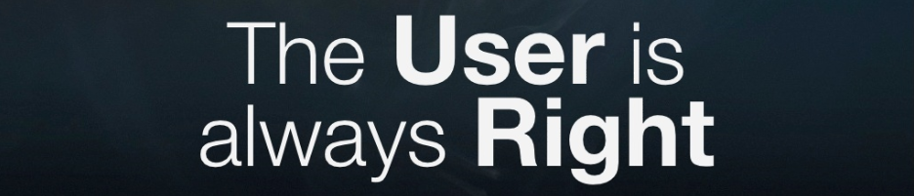
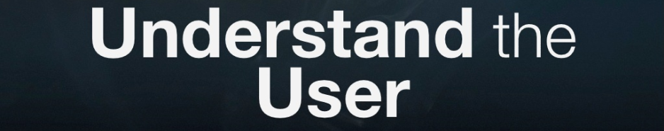
Notes:
If the user is right, that means you have to understand the user! This is major problem for providers and IT folks… this is a major problem for our organizations as a whole! we know it all…, we think we are right and we disregard the patient. Well how is that working out for you?

Slide 8
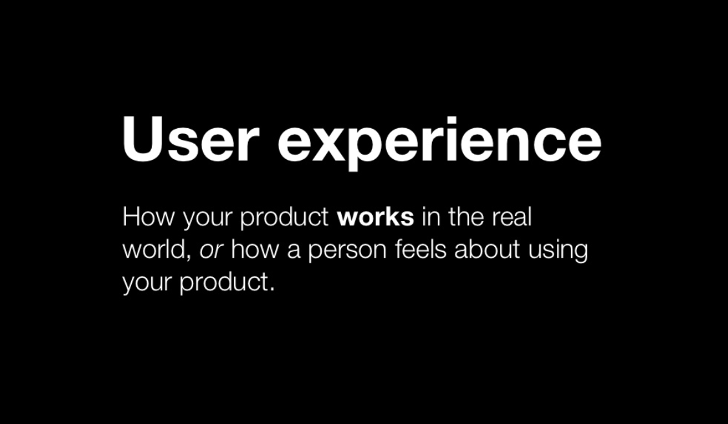
Notes:
If the user is right, that means you have to understand the user! This is major problem for providers and IT folks… this is a major problem for our organizations as a whole! we know it all…, we think we are right and we disregard the patient. Well how is that working out for you?

Slide 9
Alaska Native people experienced an average of 28.7 years of potential life lost from all-causes during the 2004-2008 time period.
Among Alaska Native people, cancer was the leading cause of death for all age groups 45 to 74 years.
http://www.anthctoday.org/epicenter/
The Alaska Native cancer mortality rate, both genders combined, was 24% higher than the U.S. White rate.
Notes:
This is great….
But they don’t listen to us… compliance, self management, etc. etc….
These are behavioral… (I hope so because behavior can change now are we are getting somewhere!)

Slide 10
engagement>adoption>usage>metrics
Notes:
Keep this always in your head, you are trying to get humans to engage! Whether it is medication compliance (which we fail at) (Matt schneilbackher) or it is staff trying a new process, technology etc…

Slide 11
engagement>adoption>usage>metrics
engagement=enthusiast/evangelist/fan-boy
adoption=loyalty
usage=compliance
metrics=accountability
Notes:
A lot of times we focus on metrics, what is your GPRA score? Notice how IPC is now all about “reporting” somebody at the top is being held accountable and needs to produce… know this now, metrics comes LAST… if you design (process) for engagement & adoption, you will get usage & metrics.

Slide 12
good design = good experience
Notes:
So it is about experiences. This might be why you see so many new UX positions. NOW more than ever it is how people experience you ecosystem. It doesn’t work if radiology is awesome but the front desk sucks.

Slide 13
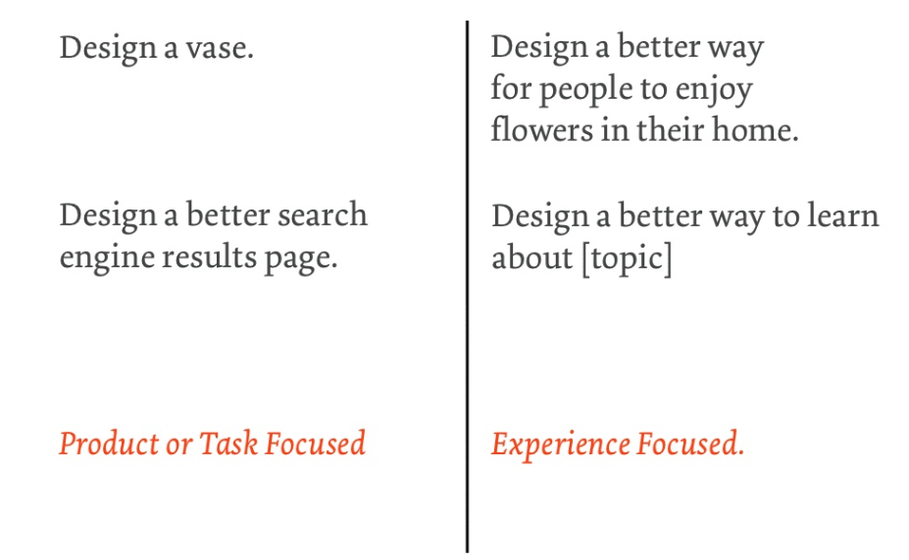
Notes:
This is probably the best literal example of how to think about things.

Slide 14
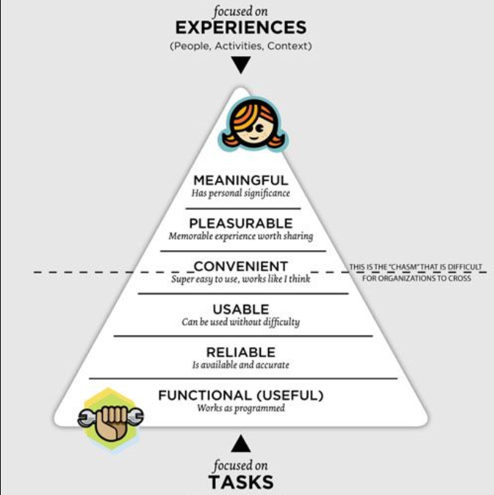

Slide 15
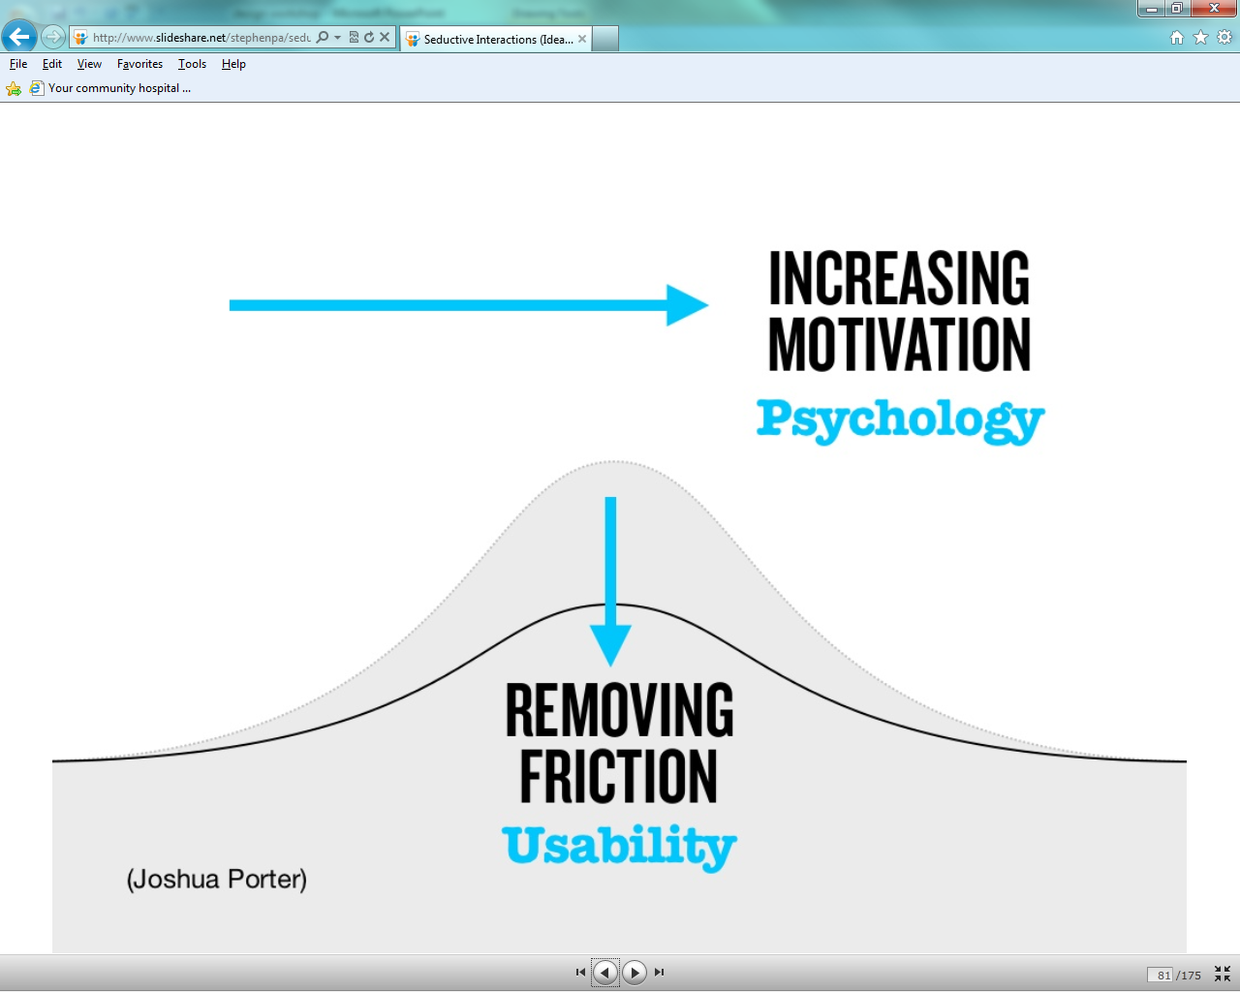

Slide 16
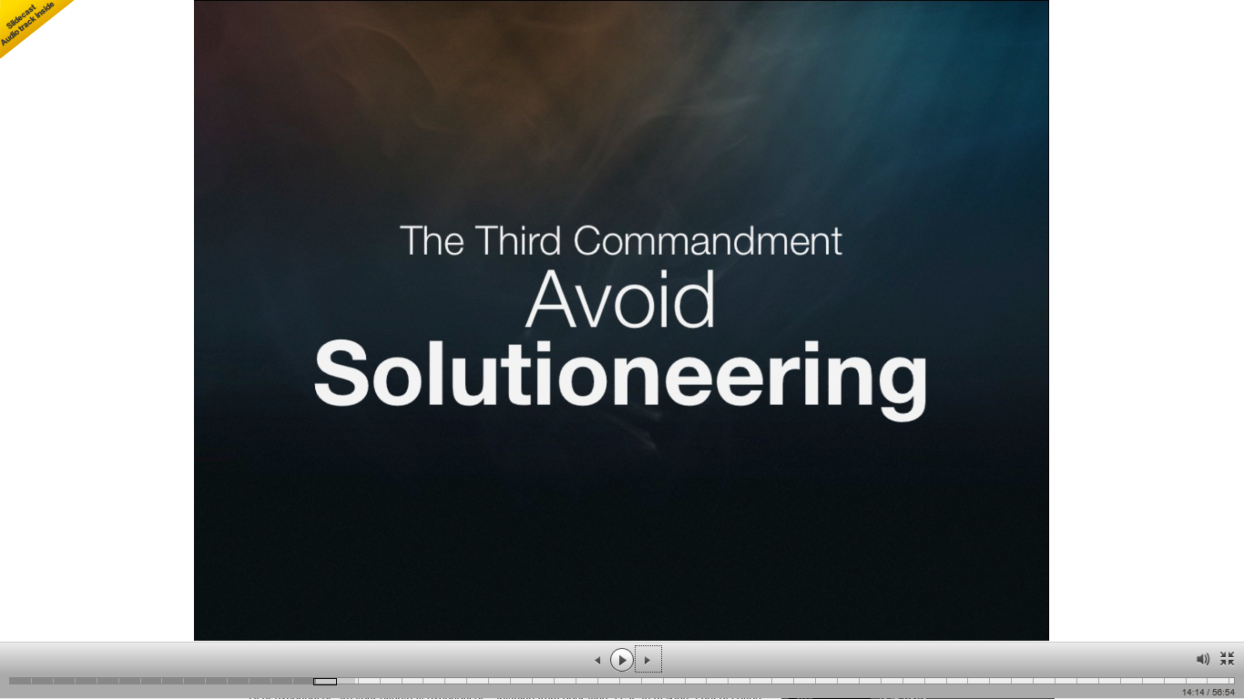
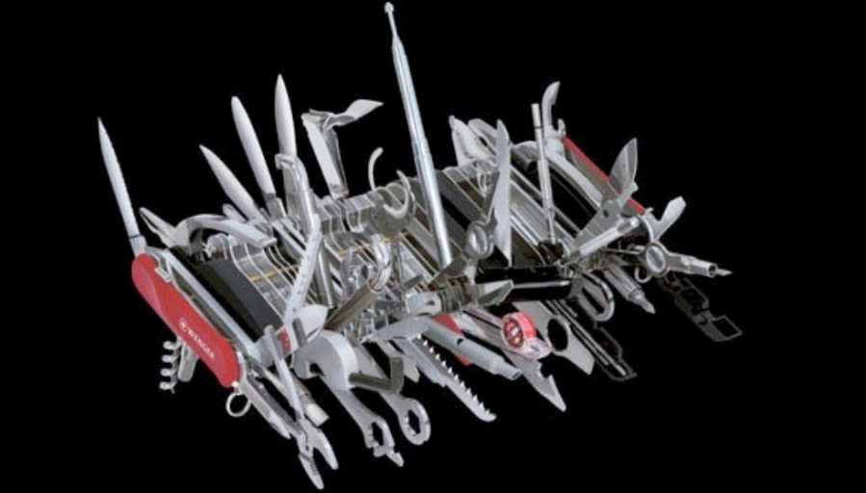
Notes:
1. Identify & fully understand the problems before finding solutions

Slide 17
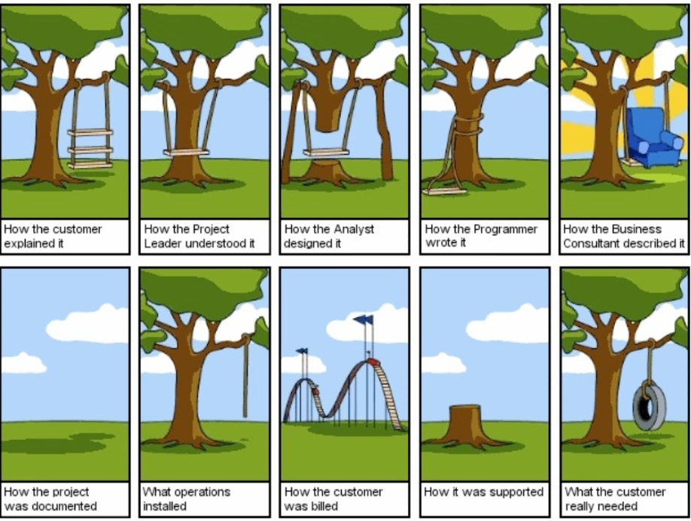
Notes:
Lets get real…

Slide 18
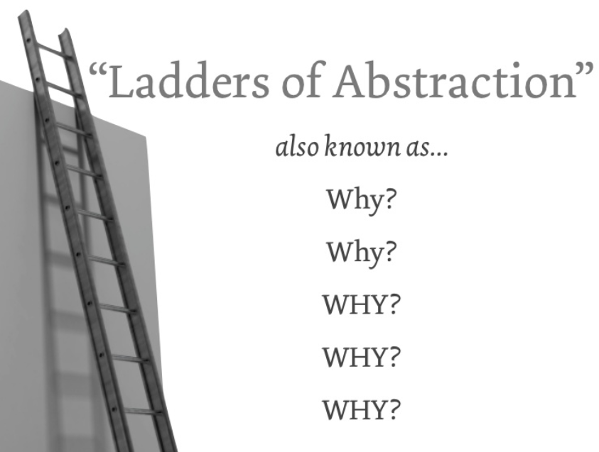
Notes:
activity…
Why do I want to track my time? To know how long we are taking
Why do you want to know how long you are taking? So I can figure out where I am underestimating my time
Why? So I can get better at estimating my time
Why? So I can have a more balanced life?

Slide 19
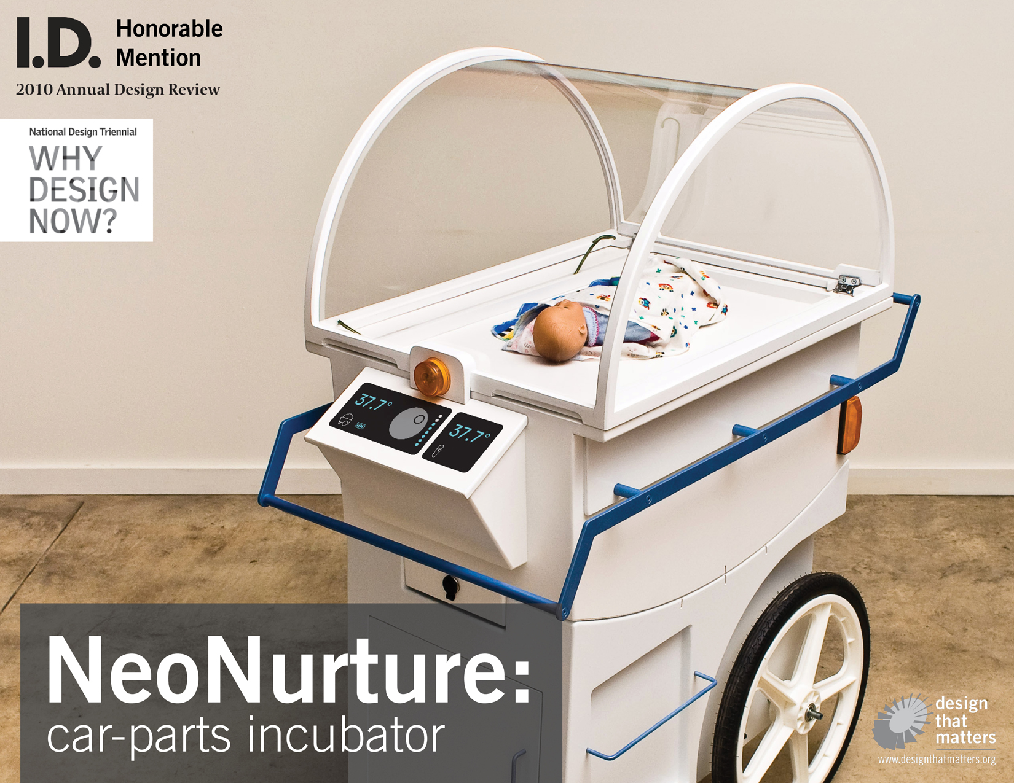
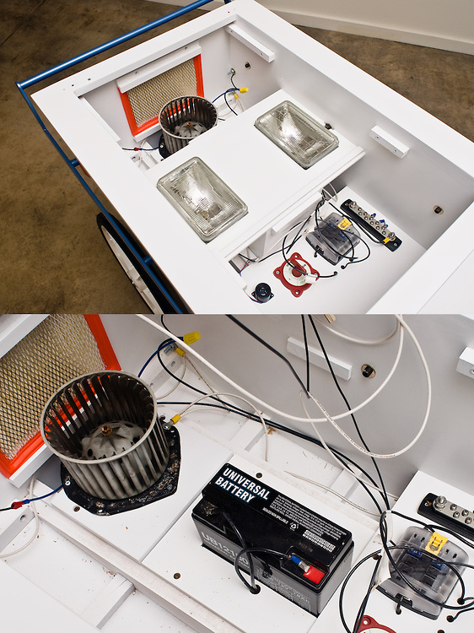
Notes:
Another way a designer thinks, this example is taken from Africa, they were depolying $70k incubators as a humanitarian aid (free)…. , they worked great for about a year or two…, until they started breaking down and there was no one to fix them, and nobody could afford to fly out the people to fix them, so they were discarded. Some designers looked at the problem. The looked around, “what do the people here do, what do they have a lot of? What do they know?” they noticed there was a lot of jalopies driving around… there was a lot of auto shops.

Slide 20
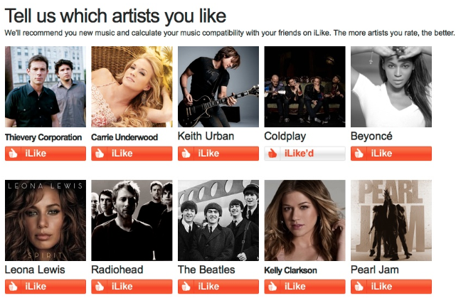
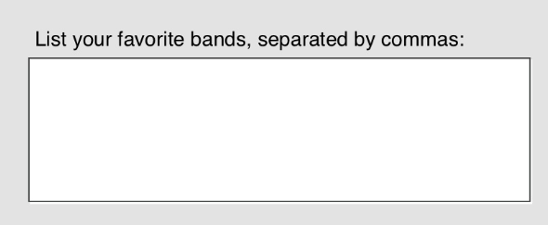
Notes:
On left is a bad example, you have all done this before, the one on the right is a better example… people put down x10 more bands
One easier, but there is something more to this… what?

Slide 21
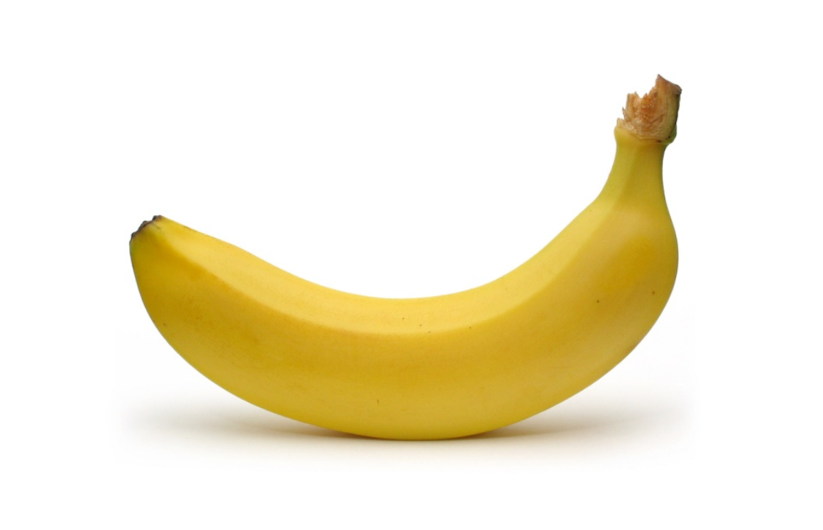
Notes:
Great design

Slide 22
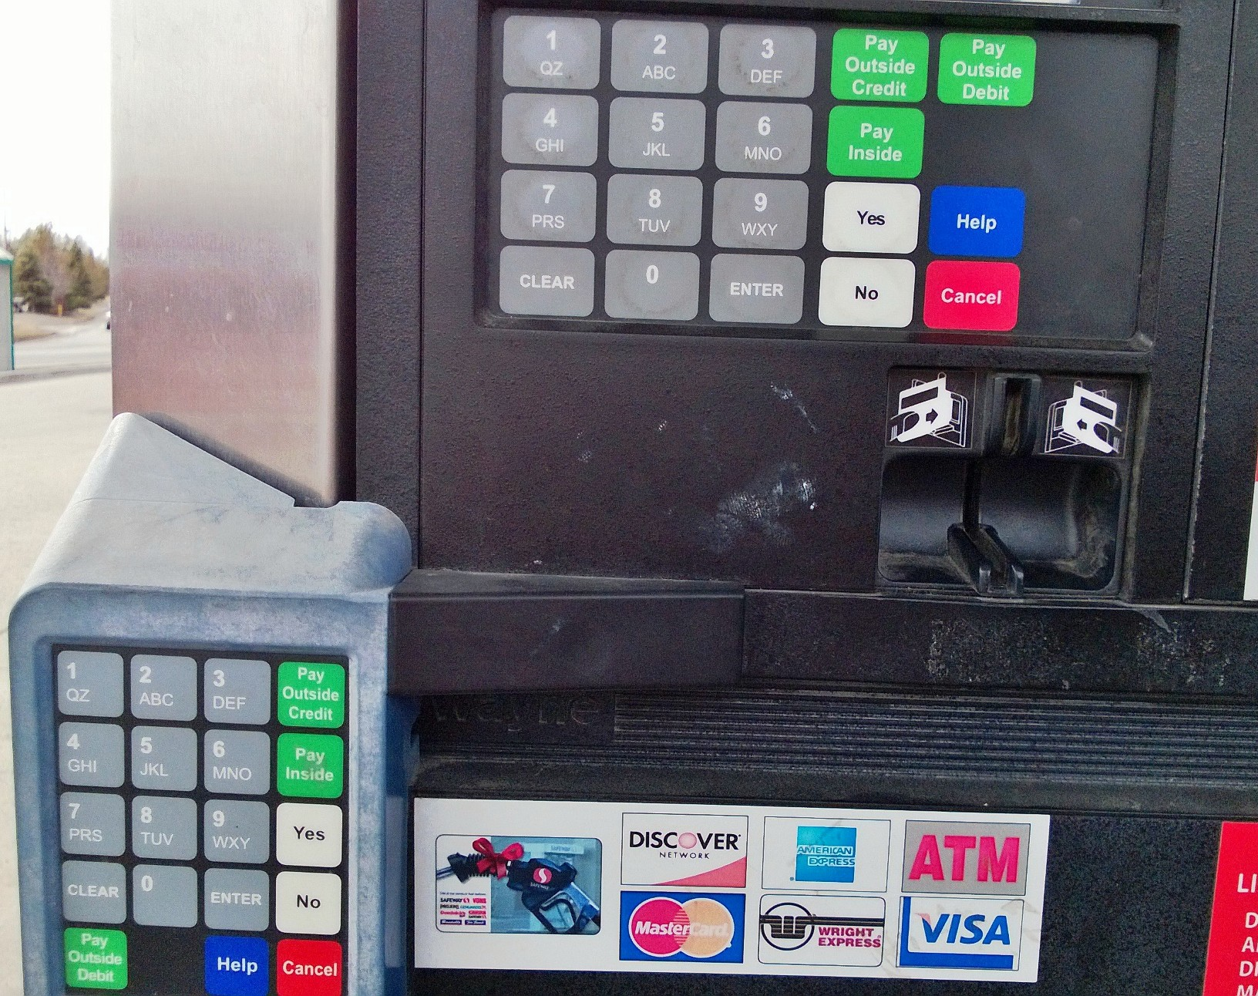
Notes:
Bad design

Slide 23
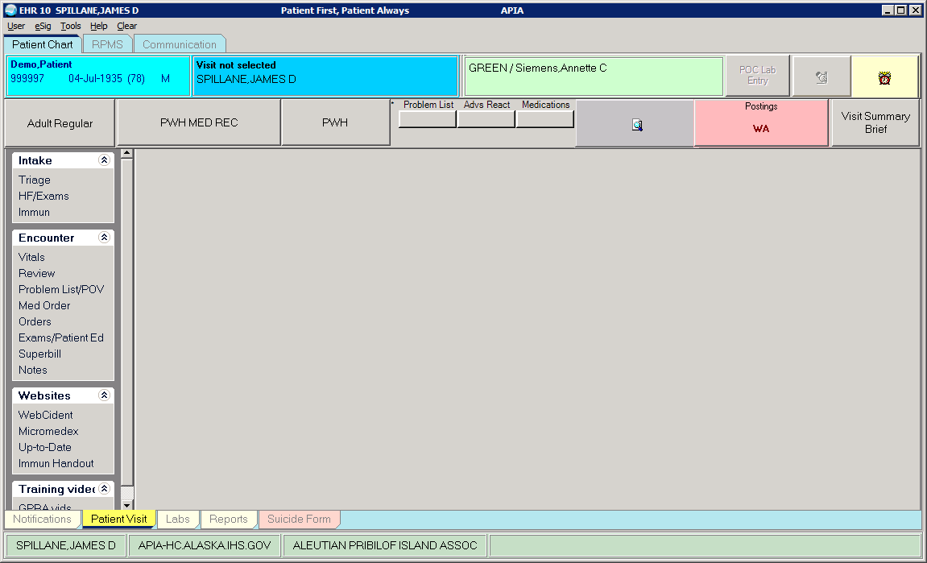
Notes:
Have fun with it. Brigg, Jessica and Jesse Anderson and I got on a call to see if we could make a touch EHR. Jesse came back with this.

Slide 24
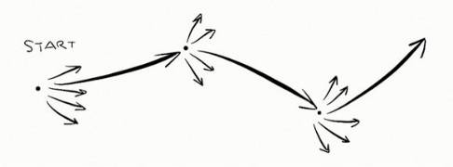
Notes:
Innovation looks like this, we don’t know what we are doing! Failure is ok, we use it as a way to ferret out what doesn’t work and confirm it, we actually design for fail and test it.

Slide 25
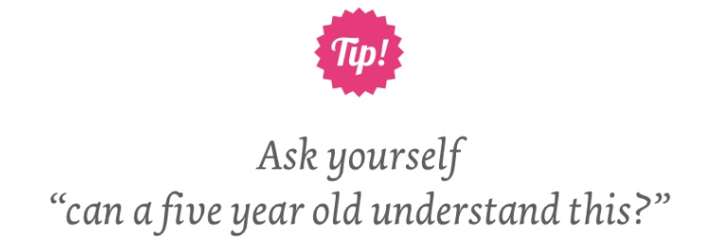
Notes:
Tip:
Have you ever watched the Kahn Academy?

Slide 26
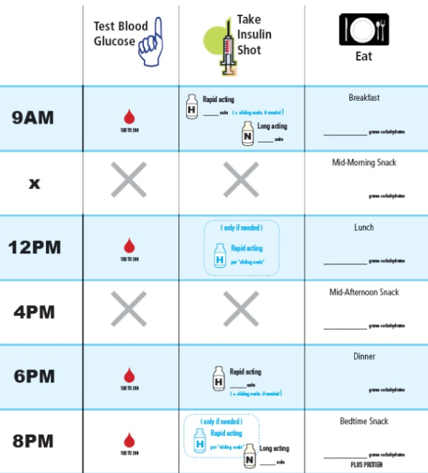
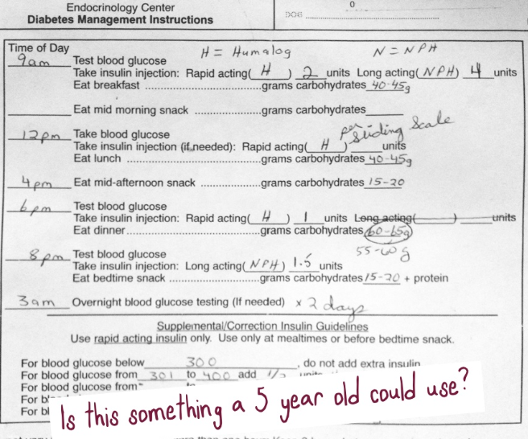

Slide 27
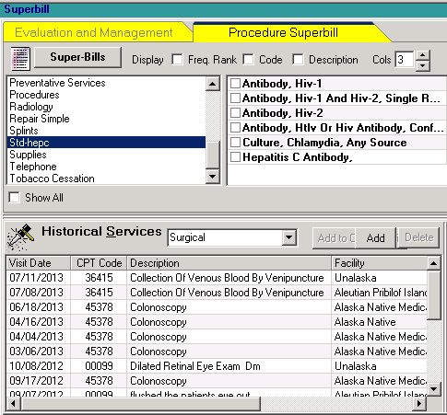
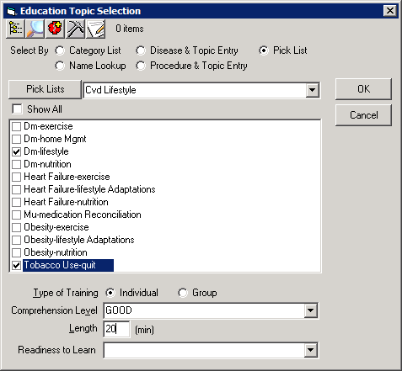

Slide 28
What actions do you want people to engage in?

Slide 29
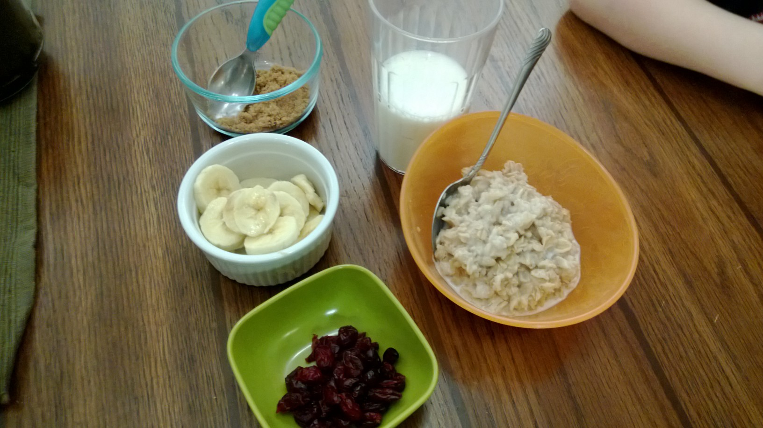
Notes:
I want Finn to eat all his food so he get’s all grown’s up… betty crocker
http://www.90percentofeverything.com/2009/10/20/just-add-an-egg-usability-user-experience-and-dramaturgy/
‘home-made’
design for experience first, then ease.

Slide 30
Set the stage for people to perform
Notes:
Design is setting the stage for people to perform, for people to experience.
We work in living systems. It is more important to look for patterns of desired outcomes and behaviors… more than One experience and flow..

Slide 31
trigger>routine>reinforcement

Slide 32
Trigger
What is the habit you want to create?
Then anchor it to an existing habit.
Then reinforce it.

