Slide 1

Customer Service

Slide 2
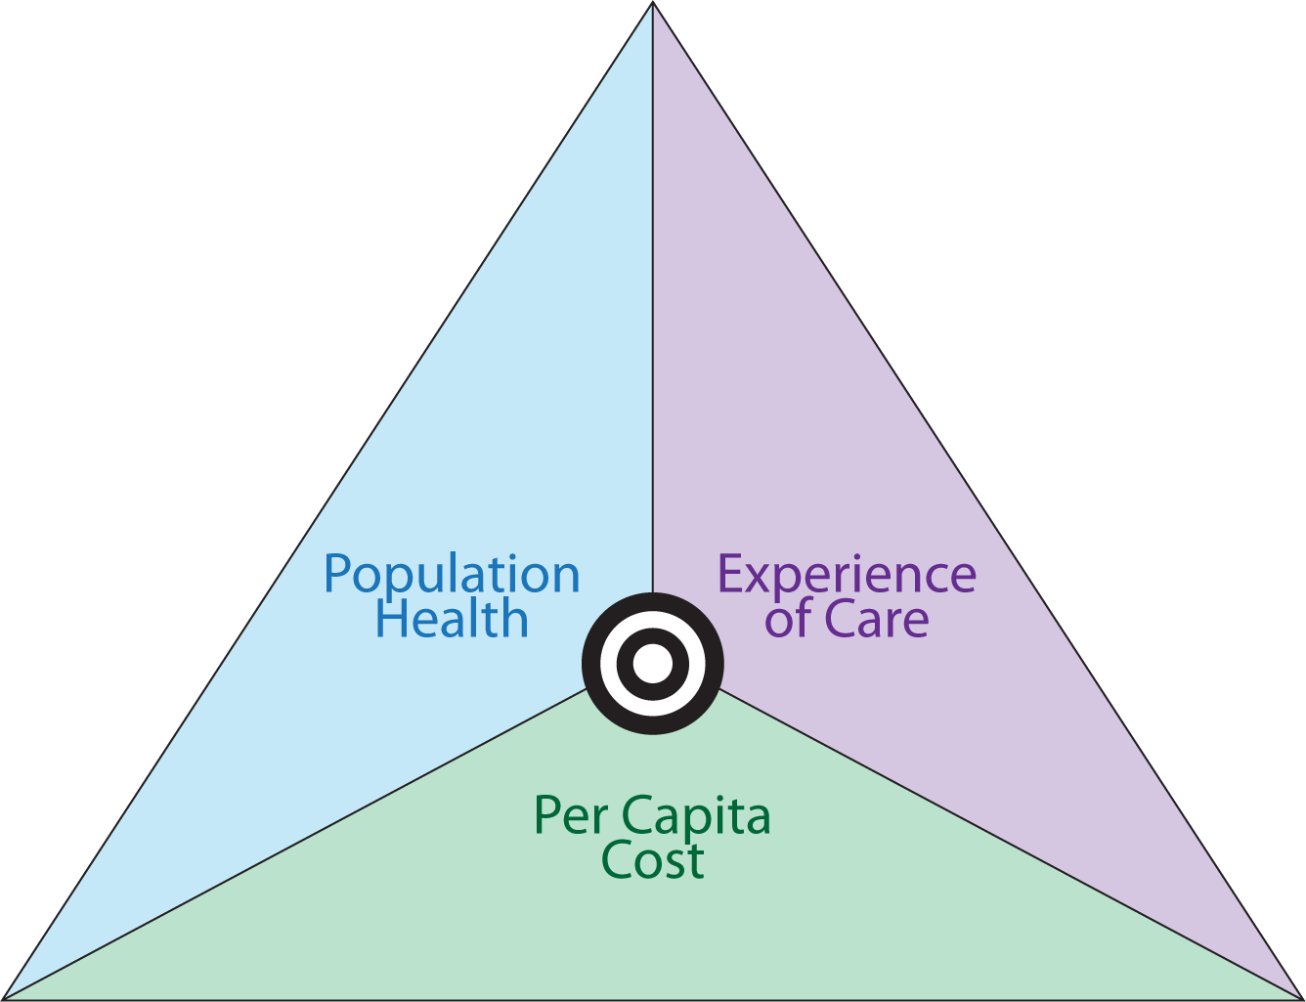
Customer Service

Slide 3


What is Customer Service?
Notes:
Real quick… I want to see what customer service means to you
Have you had training?

Slide 4
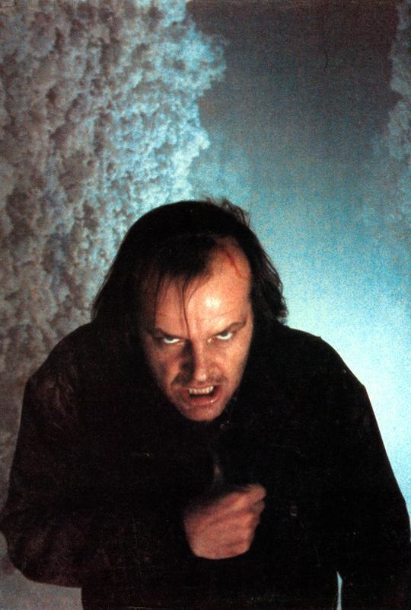
Why?
If you can prevent 5% off your customers from leaving, you can increase your bottom line profit by 25-95%
The average American business loses 15% of its customer base each year.
70% of the customers who left a business did so because of service.
- Harvard Business review

Slide 5
What if airlines operated like healthcare?

Slide 6
ACA has created new opportunities for our tribal members “a double edged sword”
The way payment models are changing
“Keeping up with the Kaisers” is the way forward
Notes:
The rise of patient experience officers
Through the Affordable Care Act's value-based purchasing (VBP) program, hospitals now face Medicare penalties based on their performance on quality and patient experience measures.
The penalties are based in part on Medicare's patient experience survey, which assesses communication from providers, the hospital's cleanliness and noise level, helpfulness of staff, discharge explanations, and other components of the patient experience.
Pay-for-performance data from around the nation
At the same time, the rise of high-deductible health plans have created savvier patients who increasingly select hospitals based on reviews, according to Paul Westbrook, the chief patient experience officer at Inova Health System.

Slide 7
ACA has created new opportunities for our tribal members “a double edged sword”
The way payment models are changing
“Keeping up with the Kaisers” is the way forward

Slide 8
New leadership opportunities
Contract Support
President Obama took action no previous United States president has done by promoting to move a portion of federal funding for American Indian tribes from “discretionary” to “mandatory non-discretionary.” This means that the devastating impacts of sequestration in recent years will no longer affect Contract Support Cost (CSC) which is a fee of sorts on top of federal funding for the administration of Indian Health Service and Bureau of Indian Affairs funding.

Slide 9


Do you know your customer?
Notes:
Exercise. Write down what you think your customer feels, wants, why are they here? How do you know?

Slide 10
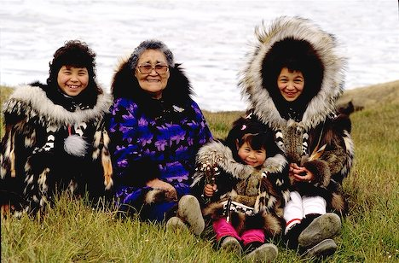
Active
listening?
Smile
Use open questions
Avoid bias
Reflect
Probe
Avoid distraction
Clarify
Summarize
Listen for feelings
Notes:
Ask lots of questions, listen
Ask the right questions, listen
Ask the right questions to the right people, shut up and listen
Active Listening
In today’s digitally distracted world, listening is becoming an increasingly rare skill. Of course, people speak at different speeds — some take longer to get to the point and some never get to a point at all. But if they are your customer, they deserve not only to be heard but to be paid attention to.
Active listening takes it a step further. It means you care enough to put the effort into providing verbal and nonverbal feedback to the person speaking, feedback that tells them you are listening and are focused on what they are saying. Nodding your head, making a quick commentary to emphasize their points, and maintaining good eye contact all signal to the listener that they, and what they have to say is important.
And eye contact means with the person,

Slide 11

How does this picture make you feel?
Notes:
Its about being human
Why, cute? Smile?

Slide 12
Do you know who is considered the leader in customer service excellence?

Slide 13
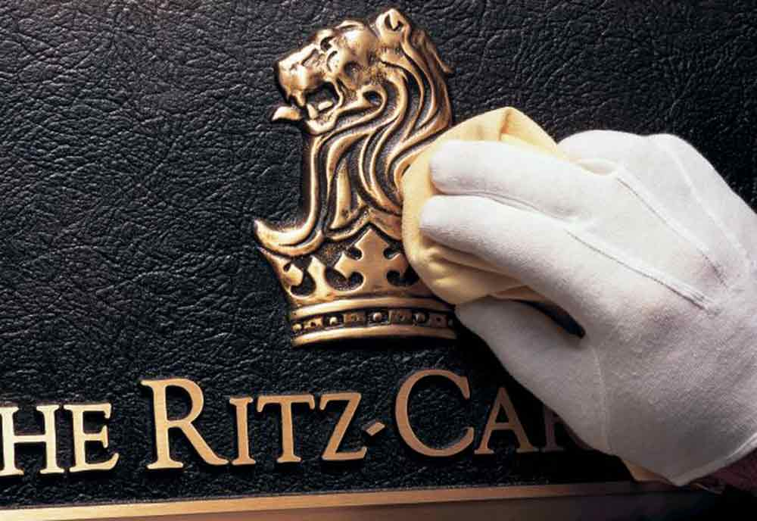

Slide 14
Ritz-Carlton Gold Standards
Our Gold Standards are the foundation of The Ritz-Carlton Hotel Company, encompass the values and philosophy by which we operate and include The Credo, The Motto, The Three Steps of Service, The Basics, and The Employee Promise.
Notes:
Really its about culture

Slide 15

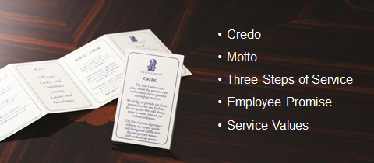
Ritz-Carlton Gold Standards

Slide 16
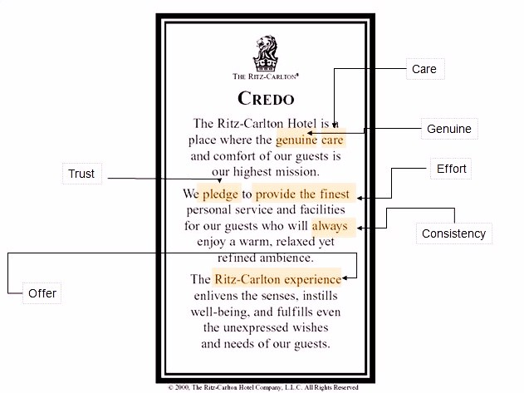

Slide 17
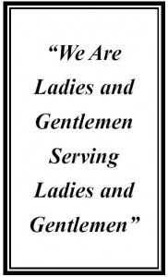
Notes:
What is this really saying and doing? (more in the basics)

Slide 18
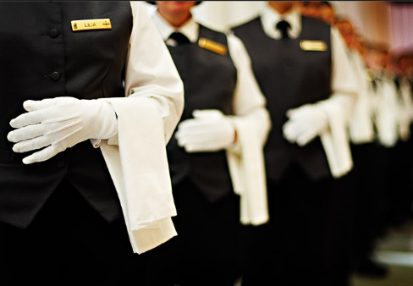
THREE STEPS OF SERVICE:
A warm and sincere greeting. Use the guest name, if and when possible.
Anticipation and compliance with guest needs.
Fond farewell. Give them a warm good-bye and use their names, if and when possible.
Notes:
Question: do you think people want to be good at service? Cheri to Jim might have different beliefs on this. Keep it simple.
Why name exercise: 40% of people are named after a relative, celebrity, or religious icon
Scenario: let’s say you are going for an important operation, your name is chad but the surgeon says, welcome Paul?
Reactive (glass of water) verse proactive (the question behind the question) dock on beach example… you mess up too, not connecting the dots… lost tons of money!
Gave AA president at a keynote a bottle of wine
Pepsi to the coca a cola chair
Sent a contract to Fed-ex, via DHL…

Slide 19
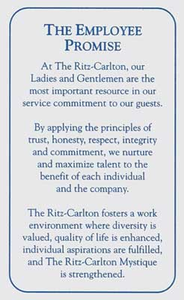
Notes:
This is there 3 legged stool, (driver) that makes them better, they use customers and employees to drive and adapt to change!
Strive to be relevant
Continue to guide organization through evolution, customers are changing, we have to track that change or we will lose relevancy.

Slide 20
BASICS:
The Credo is the principal belief of our Company. It must be known, owned and energized by all.
Our Motto is "We are Ladies and Gentlemen serving Ladies and Gentlemen." As service professionals, we treat our guests and each other with respect and dignity.
The Three Steps of Service are the foundation of Ritz-Carlton hospitality. These steps must be used in every interaction to ensure satisfaction, retention and loyalty.
Company objectives are communicated to all employees. It is everyone's responsibility to support them.
To create pride and joy in the workplace, all employees have the right to be involved in the planning of the work that affects them.
Each employee is empowered. For example, when a guest has a problem or needs something special you should break away from your regular duties, address and resolve the issue.

Slide 21
20 BASICS:
Uncompromising levels of cleanliness are the responsibility of every employee.
It is the responsibility of each employee to create a work environment of teamwork and lateral service so that the needs of our guests and each other are met
To provide the finest personal service for our guests, each employee is responsible for identifying and recording individual guest preferences.
Never lose a guest. Instant guest pacification is the responsibility of each employee. Whoever receives a complaint will own it, resolve it to the guest's satisfaction and record it.
"Smile - we are on stage." Always maintain positive eye contact. Use the proper vocabulary with our guests. (Use words like - "Good Morning," "Certainly," "I'll be happy to," and "My pleasure.")

Slide 22
20 BASICS:
Escort guests rather than pointing out directions to another area of the Hotel.
Be an ambassador of your Hotel in and outside of the work place. Always talk positively.
Use Ritz-Carlton telephone etiquette. Answer within three rings and with a "smile." Use the guest's name when possible. When necessary, ask the caller "May I place you on hold?" Do not screen calls. Eliminate call transfers whenever possible. Adhere to voice mail standards.
Take pride in and care of your personal appearance. Everyone is responsible for conveying a professional image by adhering to Ritz-Carlton clothing and grooming standards.
Protecting the assets of a Ritz-Carlton Hotel is the responsibility of every employee. Conserve energy, properly maintain our hotels and protect the environment.

Slide 23
“Anticipate unexpressed needs.“
“Radar On – Antenna Up.”
“Customers don't buy products or services. They buy good feelings. Most customer needs are emotional rather than logical. The more you know your customers, the better you become at anticipating their needs.”
-Diana Oreck Senior VP of the Ritz-Carlton Leadership Center
Notes:
Healthcare we are too logical!

Slide 24
The “WOW!” factor: Creating memorable moments
“A satisfied customer means you met expectations… that is it, you did what they expected, big whoop…. You are standard, you are average”
-Diana Oreck Senior VP of the Ritz-Carlton Leadership Center
Notes:
Cupcake on birthdays or a card… calling a taxi… etc.

Slide 25
Q. What are the biggest mistakes companies make when training customer service staff?
A. Not being specific. They’ll say things like, “Give great service.” Well that’s nice, but people need a road map. Don’t assume that their mother or father, or previous employer taught them what really great service looks like. Have a written service strategy.

Slide 26
The Six D’s
Define: it is what you want your employs to deliver, what you want to customer to experience. “helpful hardware place”
Disseminate: train your employees how to deliver it. (morning huddles pick something to go over)
Deploy: employees have been trained, everyone has it memorized, even folks that do not interface with customers, why? It is how we treat each other
Demonstrate: to each-other, everyone is a role model
Defend: if you see something is wrong, step in as a role model
Delight: celebrate it, reward employees who have demonstrated successful customer service.
Notes:
So how do we get there, what's next?
Exercise

Slide 27

Mother Standard of Care
Notes:
If your mother had cancer, how would you want her to be treated? That simple question has evolved into the Mother Standard® of care in which every employee at Cancer Treatment Centers of America® (CTCA) is empowered to follow. The Mother Standard represents a compassionate approach that delivers a patient-focused treatment experience.

Slide 28
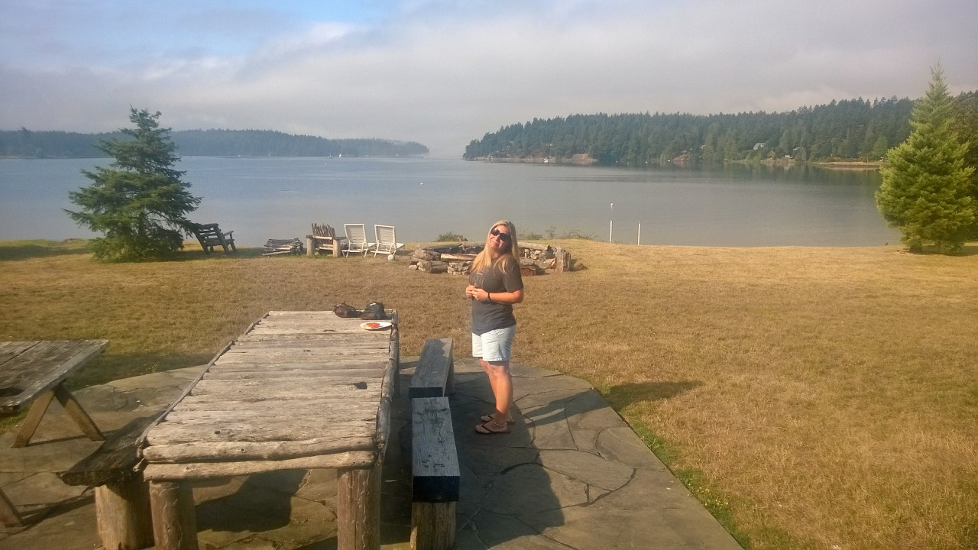

Slide 29



Slide 30
“I always pretend everyone is dad… you know how he was always aloof , and how mom was always afraid of the kiosks.”
Southwest believes in the gray, there is no black and white when it comes to the customer, they give us the right to make on the spot decisions, some airlines are like, ‘you are 51lbs, you have to remove a pound’ we just let it slide, we can also discount flights, let’s say for a funeral, it is up to us”
You learn positive framing real quick
Notes:
If your mother had cancer, how would you want her to be treated? That simple question has evolved into the Mother Standard® of care in which every employee at Cancer Treatment Centers of America® (CTCA) is empowered to follow. The Mother Standard represents a compassionate approach that delivers a patient-focused treatment experience.

Slide 31
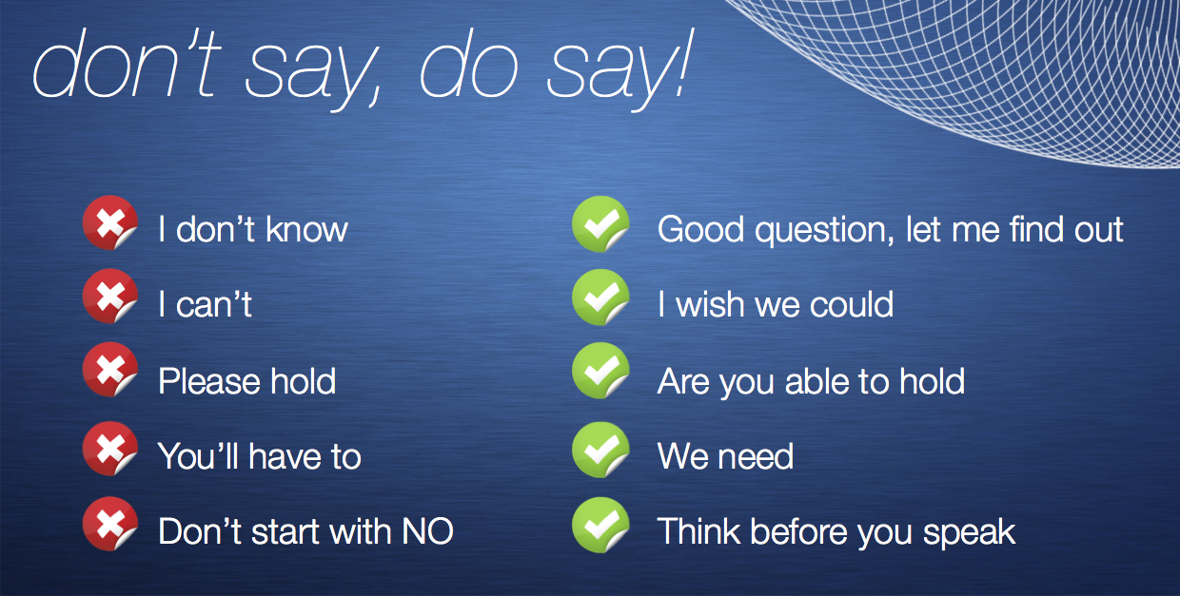
Notes:
We don’t have any available appointments today… our schedule is full
Or
We have an opening tomorrow morning or afternoon, what works better.

