Slide 1
Being Human
behavioral economics
and other cool s#!+
Notes:
We have to keep people’s attention, have some fun with it
“you” “John”

Slide 2
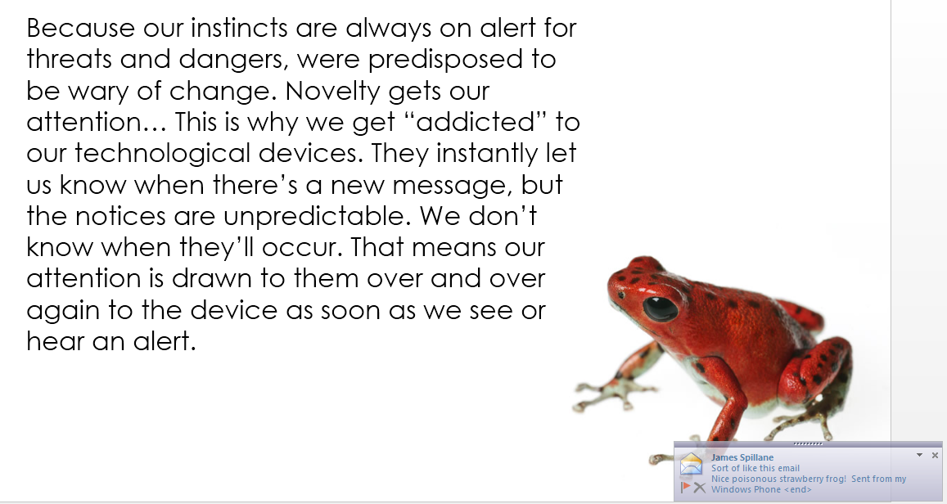
Notes:
We have to keep people’s attention, have some fun with it
“you” “John”

Slide 3
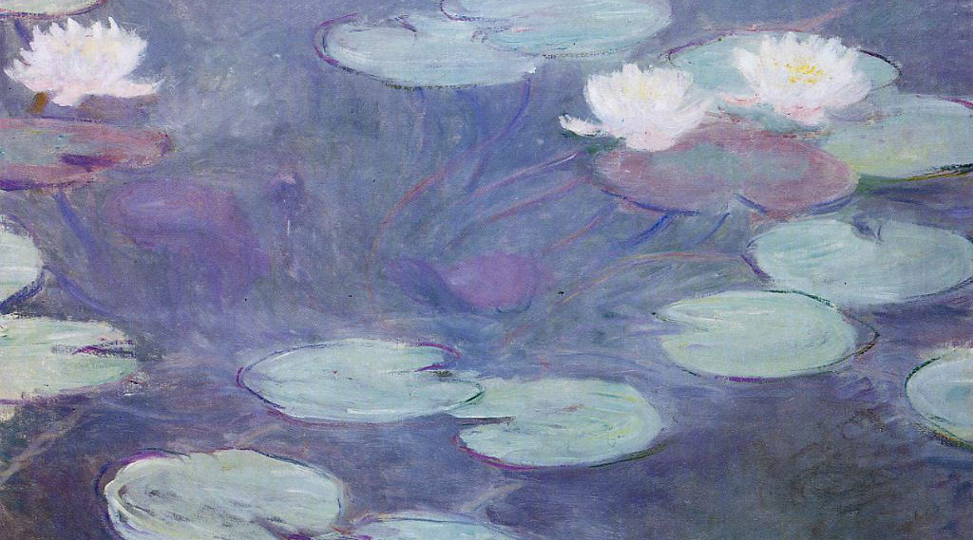
In a lake there is a patch of lily pads. Every day the patch doubles in size. If it takes 48 days for the patch to cover the entire lake, how long would it take for the patch to cover half the lake?
Notes:
1st brain… if you read it easy in easy font 30% get it right
You make it hard to read, 70% get it right.

Slide 4
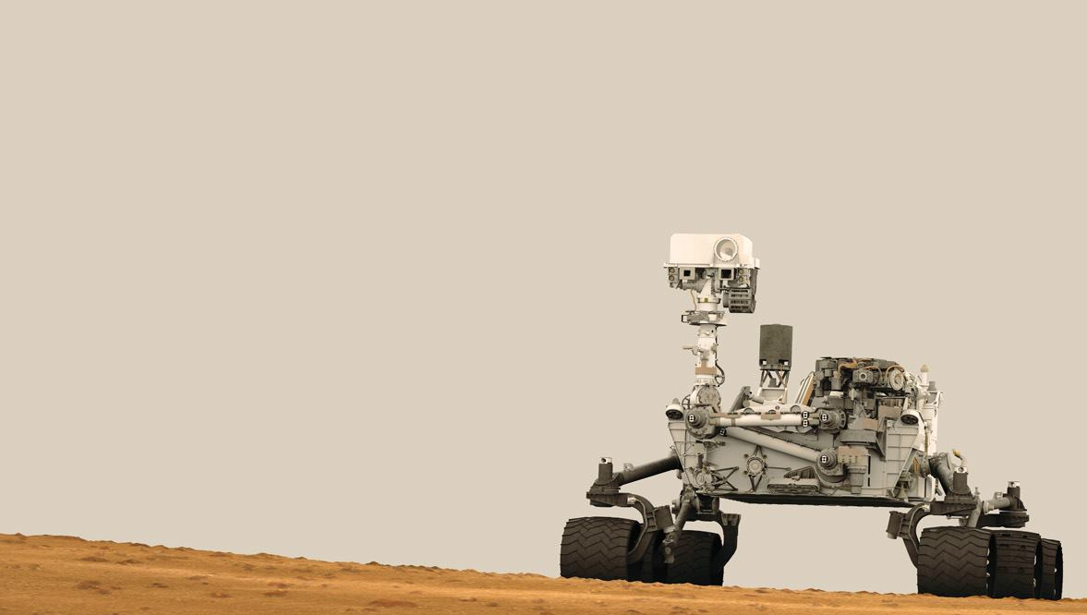
“Dopamine makes us curious about ideas and fuels our search for information. Dopamine is critical from and evolutionary standpoint. If humans had not been driven by curiosity … then they would’ve just sat around in their caves. The dopamine seeking system kept our ancestors motivated to move through the world, learn, and survive.”
Learn how to apply curiosity
to your work!
Notes:
We are naturally curious

Slide 5
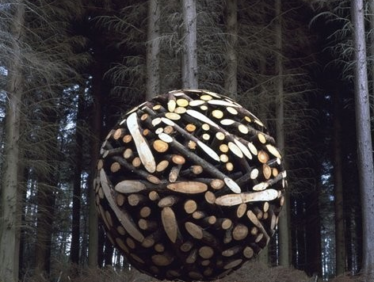
How do you encourage people to consume more information?
Notes:
Weird picture huh?
Get Weird!

Slide 6
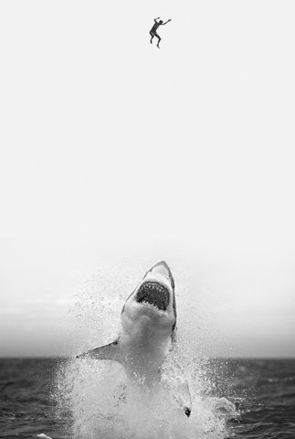
Break it up
Notes:
This is really about engagement. Just think of “Chopped, Dancing with the Stars, Voice, etc”
Sting you along, leave you hanging

Slide 7
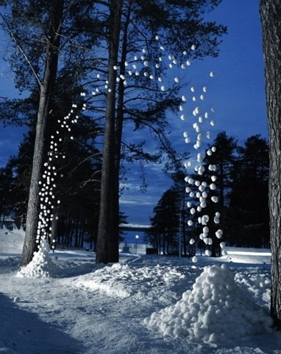
Priming
If I show you the word
HOCKEY
Then the word
P_CK
Notes:
You can prime improvement! You can prime the way people think about things, it can be negative or in our case, positive.
You automatically insert “U”

Slide 8
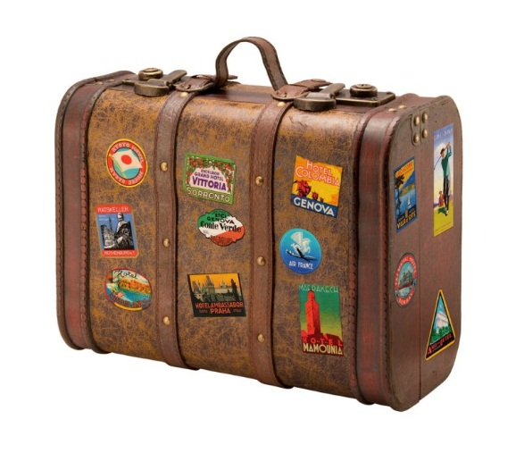
If I show you the word
SUITCASE
Then the word
P_CK
Notes:
You insert A, why not U?… there is no rules to this game.

Slide 9
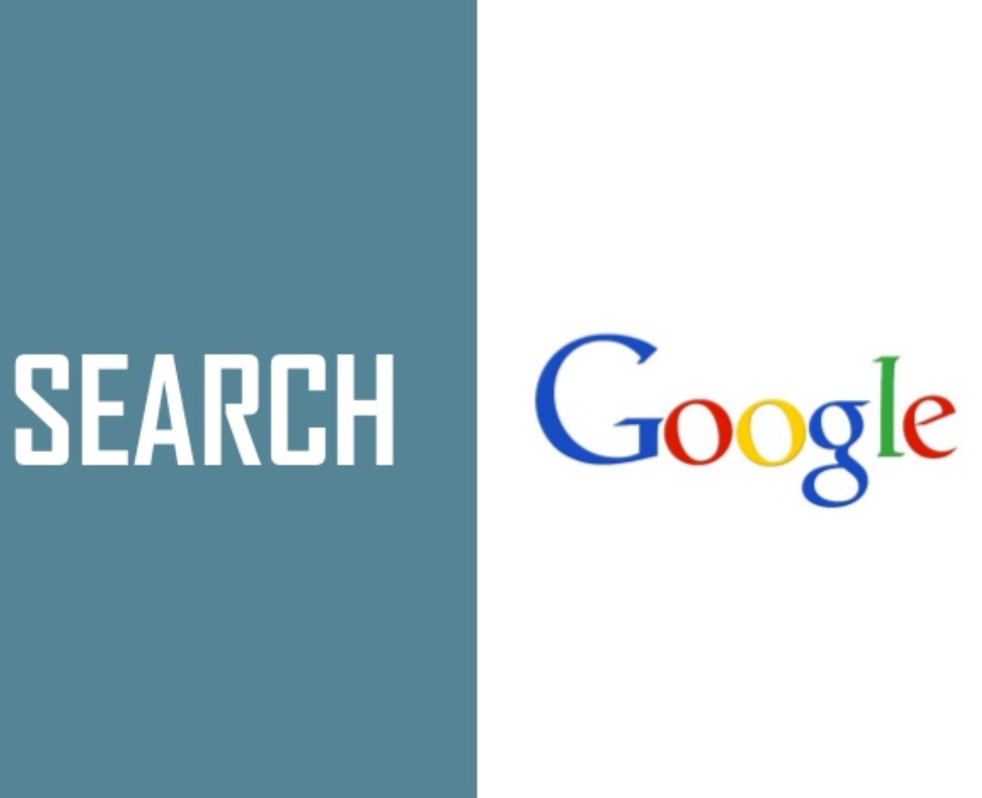
Notes:
Associations. Our “1st brain jumps to conclusions”

Slide 10
“Tim had an argument with his brother. The next day he showed up with bruises all over his body.”
Correlation does not imply causation
Notes:
Scientists hate these sorts of sentences and statements because it implies.
Be on the look out… but also, if we are going to make correlation, do it for the positive. HAPPINESS

Slide 11
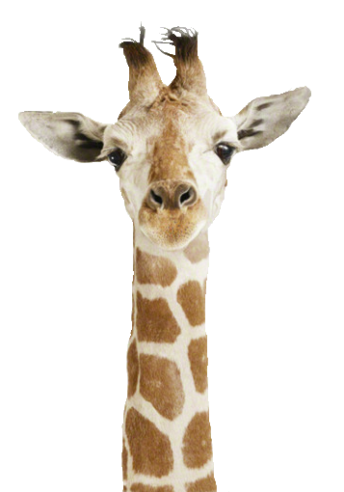
“How many animals of each kind did Moses take onto the ark?”
Notes:
Moses didn’t take anyone on the ark, it was Noah.

Slide 12
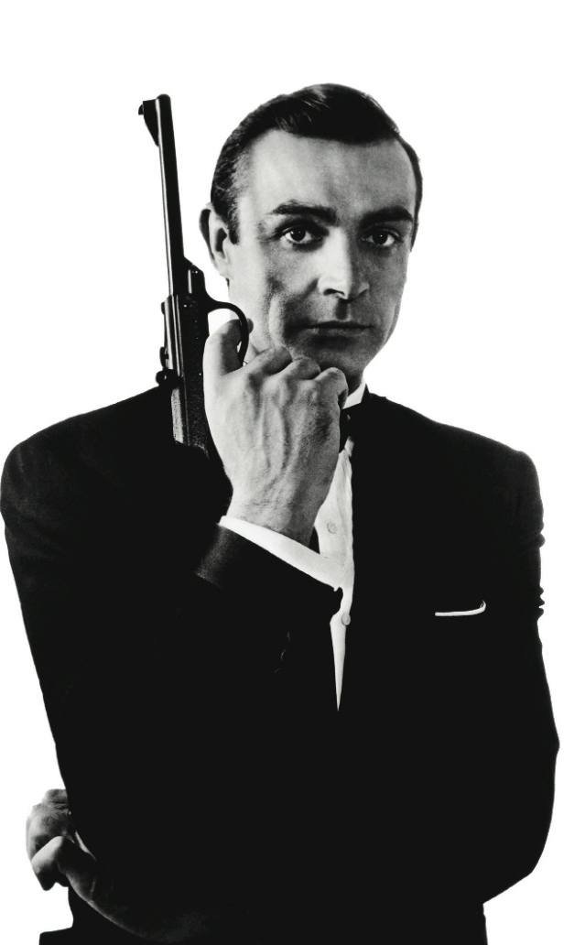
“How many animals of each kind did James Bond take onto the ark?”

Slide 13
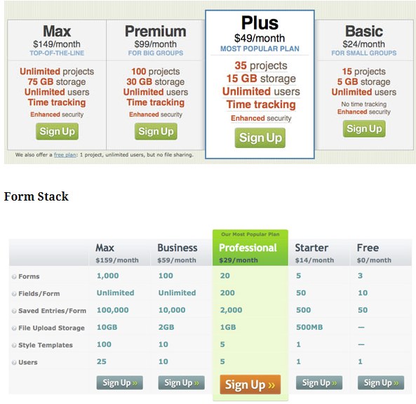
Managing expectations &
Anchoring
Notes:
anchoring occurs when individuals use an initial piece of information to make subsequent judgments. Once an anchor is set, other judgments are made by adjusting away from that anchor, and there is a bias toward interpreting other information around the anchor. For example, the initial price offered for a used car sets the standard for the rest of the negotiations, so that prices lower than the initial price seem more reasonable even if they are still higher than what the car is really worth
-Highlight the differences not the similarities in offerings
-List highest to lowest prices from left to right or top to bottom
-Create a middle-of-the-road, best deal offering
-The cheapest offering should be decent but not overly attractive

Slide 14
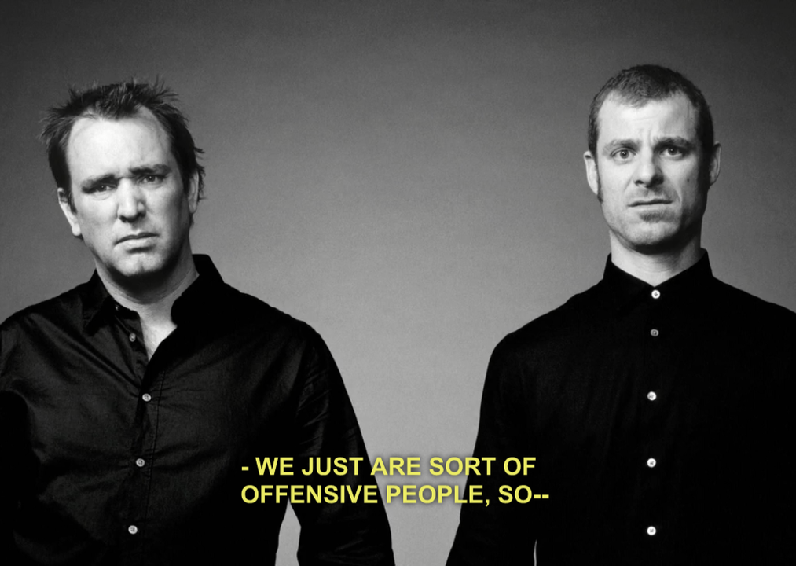
Managing expectations &
Anchoring
Notes:
Boy Scout candy bar… Hawaii… no, ok want a candy bar… of course.
South park…

Slide 15
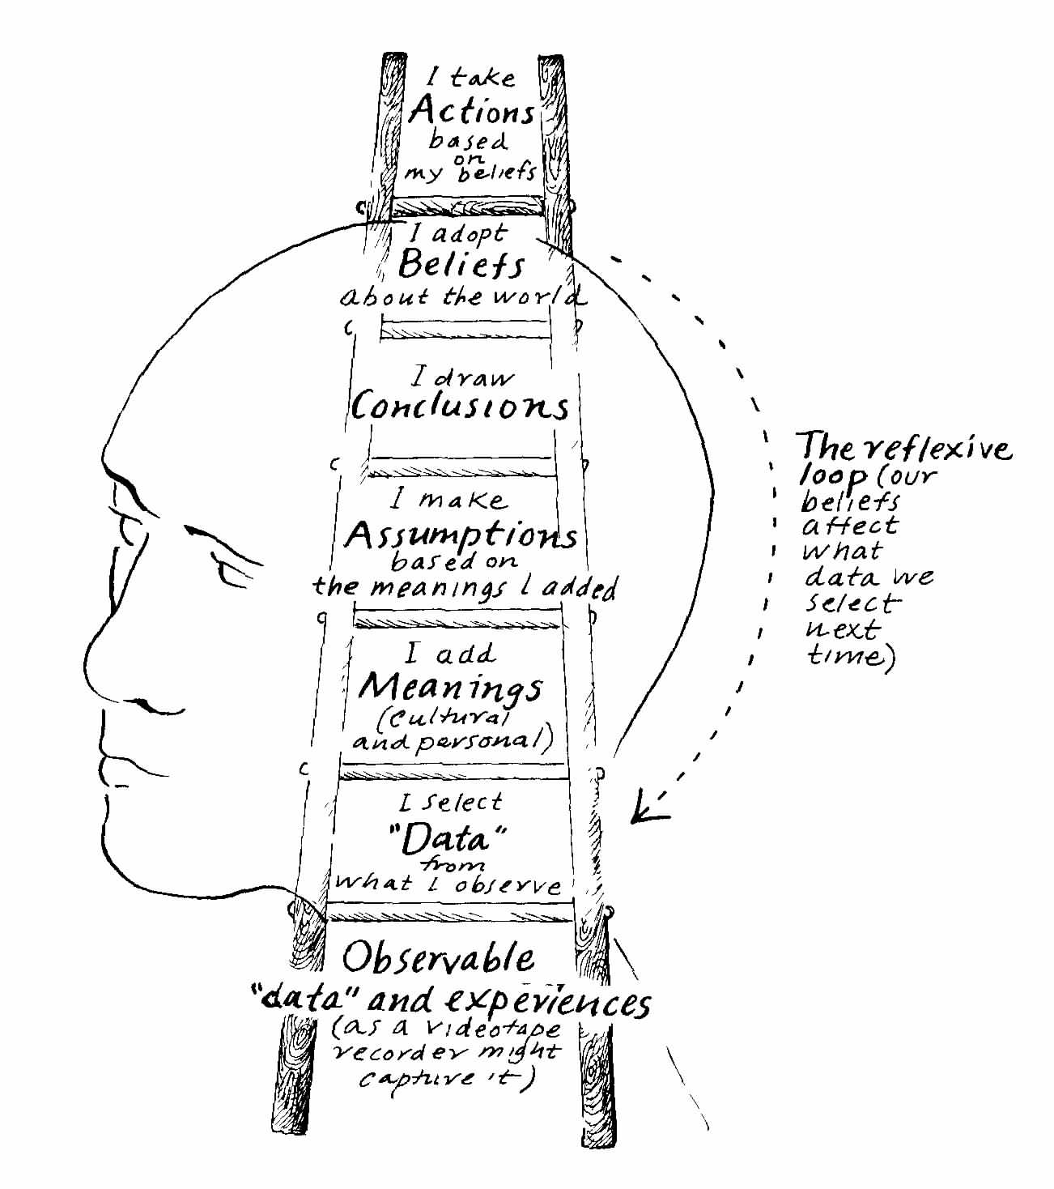
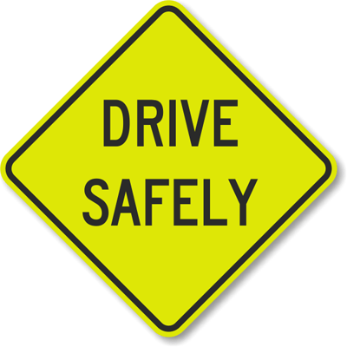
Cognitive dissonance is a psychological term describing the uncomfortable tension that may result from having two conflicting thoughts at the same time, or from engaging in behavior that conflicts with one's beliefs, or from experiencing apparently conflicting phenomena. In simple terms, it can be the filtering of information that conflicts with what you already believe, in an effort to ignore that information and reinforce your beliefs
Notes:
Start with something the agree on and build off of that!!!
Example of the “drive safely” sign.

Slide 16
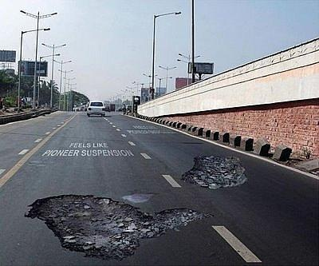
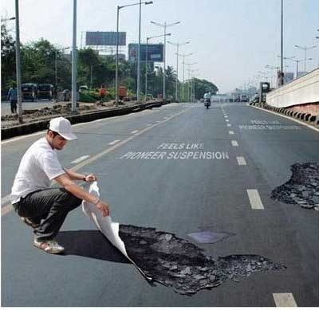
Fun sidebar stuff

Slide 17
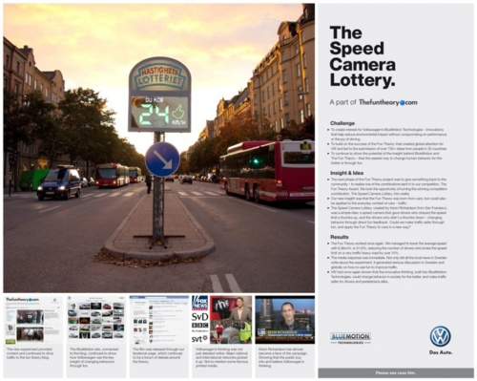
Fun sidebar stuff: Gamification and Behavioral Economics
Notes:
Intrinsic vs extrinsic motivators.

Slide 18
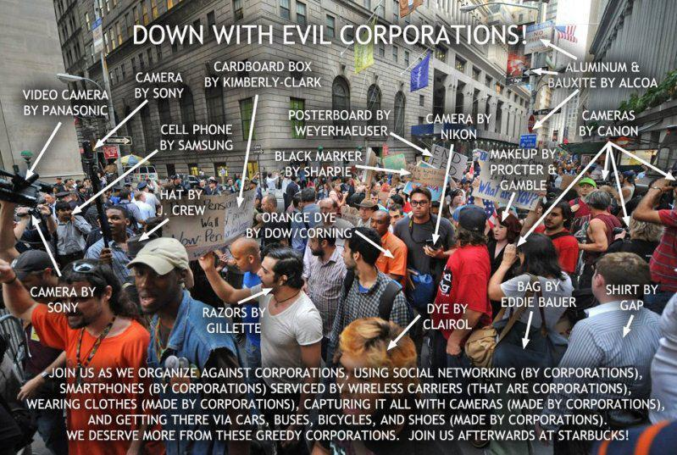
Notes:
We are all idiots.

Slide 19
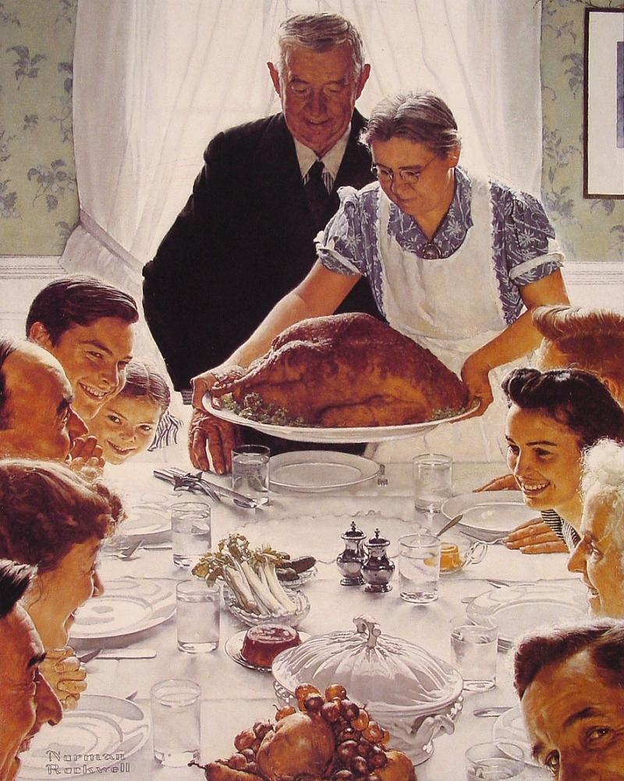
Establishing Artificial Time Constraints
The first step in the process of developing great rapport and having great conversations is letting the other person know that there is an end in sight, and it is really close.
When you approach someone to start a conversation most people assess the situation for threat before anything else. Humans have genetically survived because of this. This is a strong reason why these techniques work; they are specifically designed to lower the perceived risk to a stranger.
Notes:
Let everyone know it is safe!

Slide 20
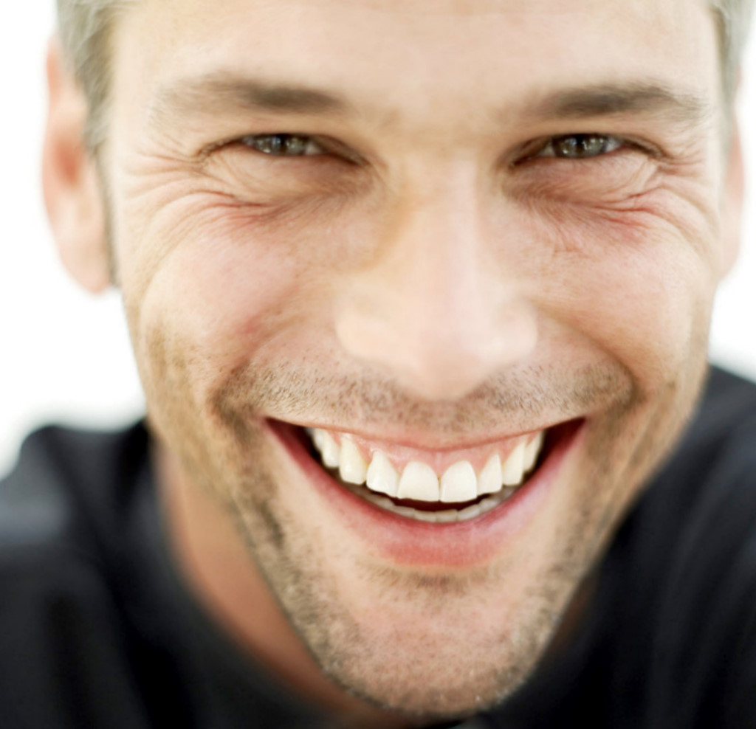
Accommodating Non-verbal's
You want to look non threatening. The number one nonverbal technique to use to look more accommodating is to smile.
You can however accentuate your smile in a subtle way.
Adding a slight head tilt shows the other person that you have comfort with them and trust them. Another nonverbal to try and maintain is a slightly lower chin angle.
High chin angles make someone feel like you’re looking down at them.
Another key nonverbal is body angle. Standing toe to toe with someone else can be intimidating. A slight body angle or blade away from the individual you are engaging will present a much more accommodating nonverbal.

Slide 21
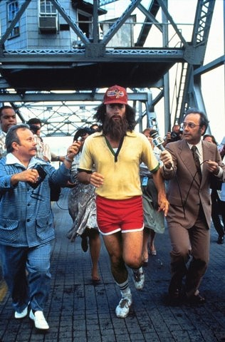
Slower Rate of Speech
Speaking fast may mean you’re excited. It may even mean that you know what you’re talking about. However speaking slowly gives you more credibility.
Whenever I have a conversation that I believe is important for me to be credible in my content, I purposely slow down the delivery
Notes:
This is my problem. I get too excited. Slow down.

Slide 22
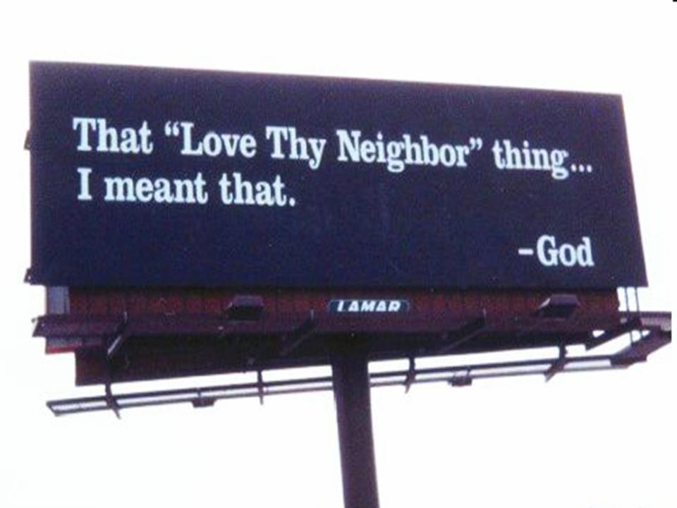
Sympathy or Assistance
As human beings, we are biologically conditioned to accommodate requests for assistance. The compulsion is based upon the fact that our ancient ancestors knew that if they did not provide assistance when asked, the assistance would not be granted to them if requested at a later date.
Notes:
If you need for help, ask for it… it is sometimes the fast way. Think about ideas, maybe you need help with spreading a concept or idea.

Slide 23
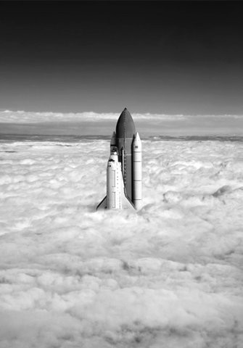
Ego Suspension
Suspending your ego is nothing more complex than putting other individuals’ wants, needs, and perceptions of reality ahead of your own. Most times, when two individuals engage in a conversation, each patiently waits for the other person to be done with whatever story he or she is telling. Then, the other person tells his or her own story, usually on a related topic and often times in an attempt to have a better and more interesting story. Individuals practicing good ego suspension would continue to encourage the other individual to talk about his or her story, neglecting their own need to share what they think is a great story.
Notes:
I am guilty of this. Reading Eckhart Tolle and Dali Lama.
Think of individuals you know. Dr. Onders

Slide 24
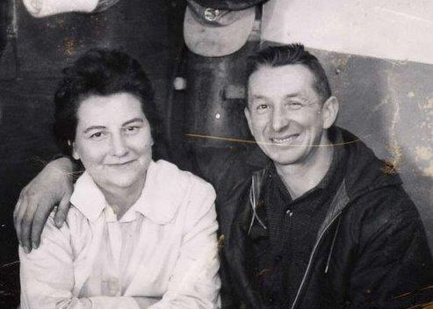
Validate Others
Listening: This is the simplest and one of the most effective. Just listen to someone can produce amazing results.
Thoughtfulness: we really like the person who gives it. Demonstrating thoughtfulness in words and actions with everyone in our lives is a simple and effective way to improve our relationships. (random)
Validate Thoughts and Opinions: honestly understand the other person’s point of view and then build upon that base with your ideas.
Notes:
Think of marriage

Slide 25
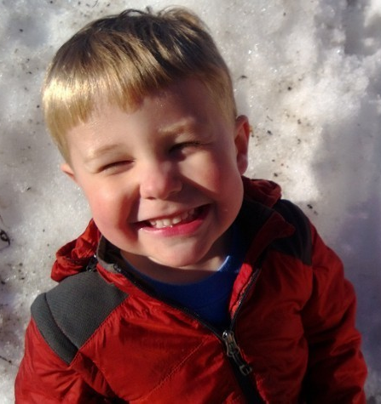
Ask … How? When? Why?
It’s hard to answer these questions with a simple yes or no. A great conversationalist will utilize the content given and continue to ask open ended questions about the same content. This means suppressing your ego and listening to what people are saying.
Notes:
Kids vs. Teenagers… real life.

Slide 26
Connect with Quid Pro Quo
If someone is introverted or suddenly feels that they have been talking to much, make yourself vulnerable and give up something about yourself to even to conversation
Gift Giving
Reciprocal altruism, is hardwired in our genetics. The key is to do this without an agenda and honestly, even if it is a point of view. Compromise
Manage Expectations
Regardless of the situation, whether it is an altruistic intention or not, there is an agenda. Just be realistic

Slide 27
LOVE
Notes:
Do what you love, love what you do

