Slide 1
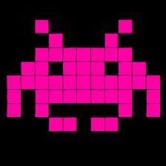
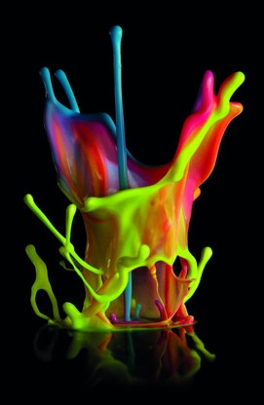

GAME
ON/+
JamesSPILLANEIS

Slide 2
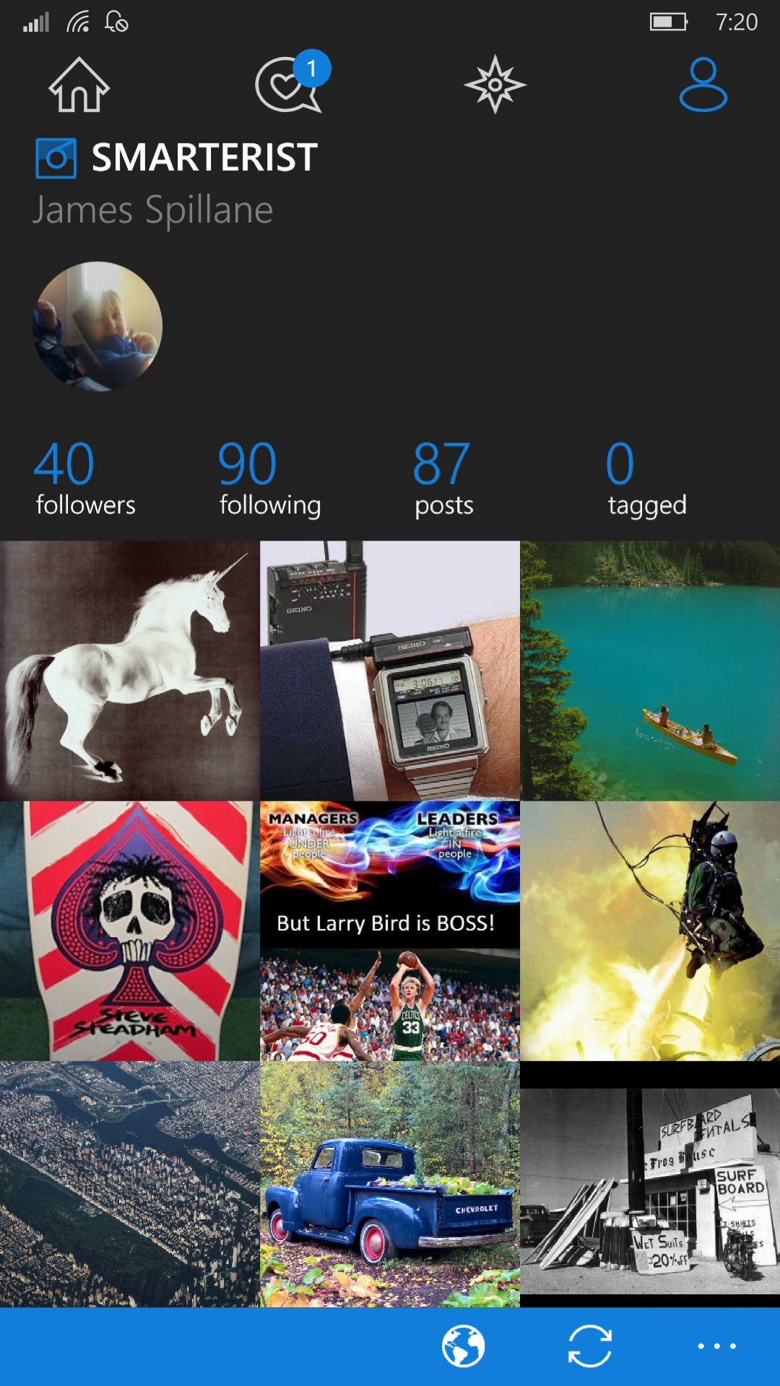

Slide 3
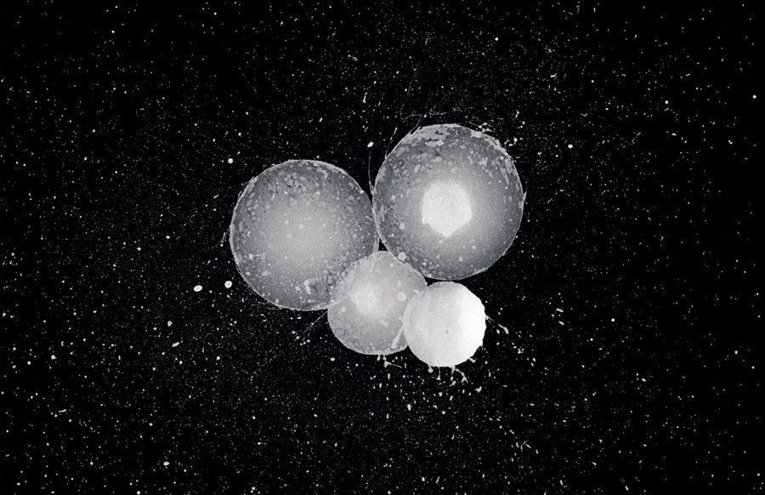
simplicity is advanced, complexity is primitive
people
feedback
fun
Notes:
We over think things… Its all about being MORE HUMAN

Slide 4
Appreciation for the system
Understanding variation
Building knowledge
Human side of change
Dr. W. Edwards Deming’s System of Profound Knowledge
Notes:
Numbers people.

Slide 5
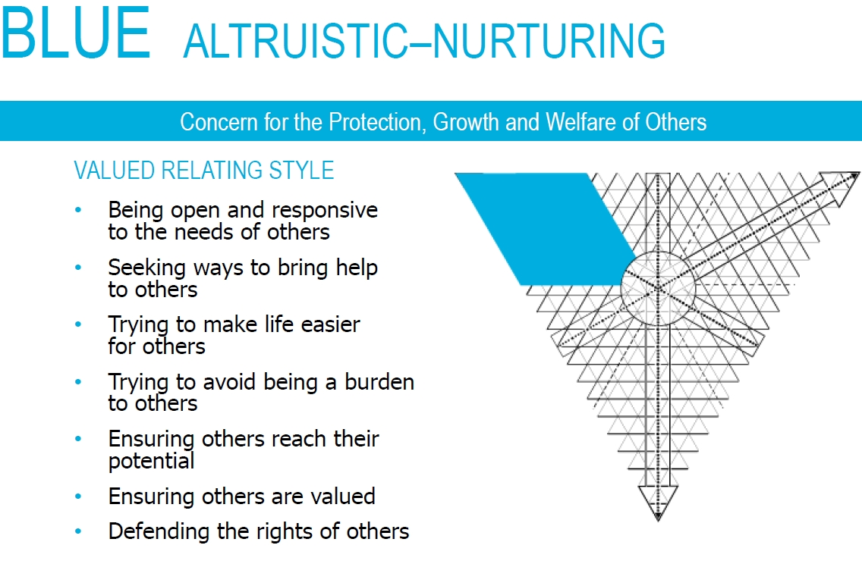
Source: Strength Deployment Inventory www.personalstrengths.com

Slide 6
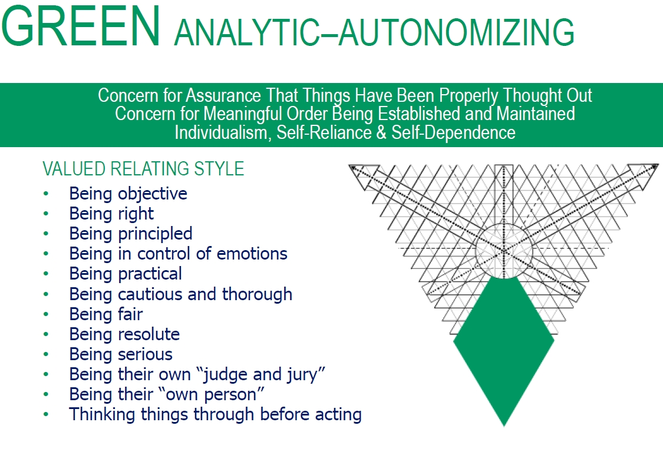
Source: Strength Deployment Inventory www.personalstrengths.com

Slide 7
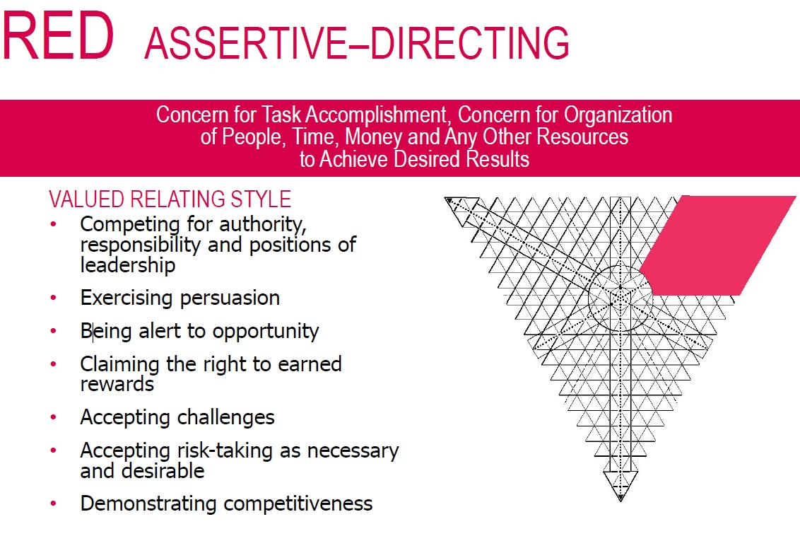
Source: Strength Deployment Inventory www.personalstrengths.com

Slide 8
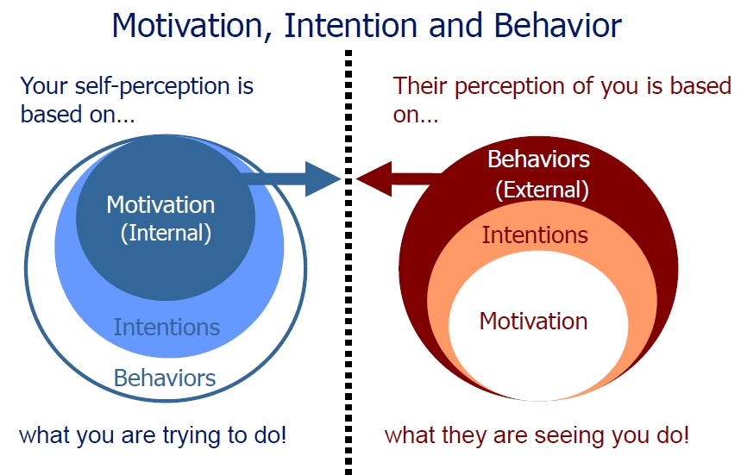
Source: Institute for Healthcare Improvement www.ihi.org
Notes:
Behaviors are by products of motivation?

Slide 9
where does motivation come from?

Slide 10
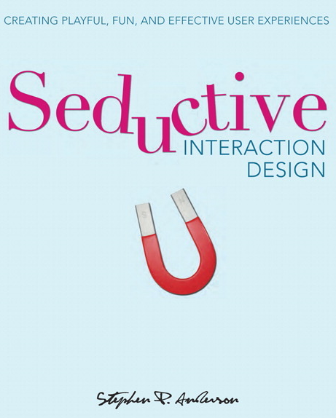



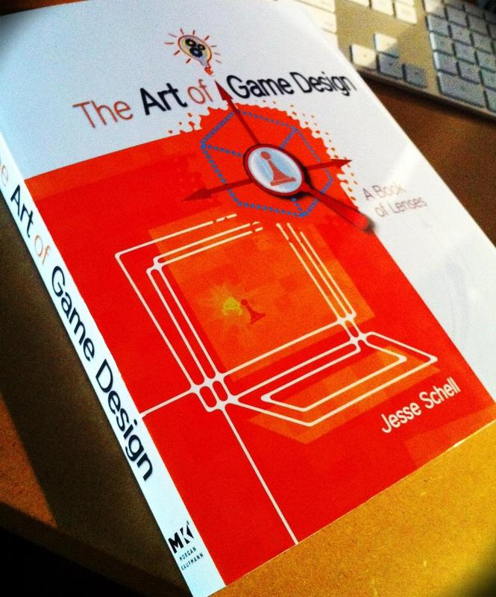

Slide 11
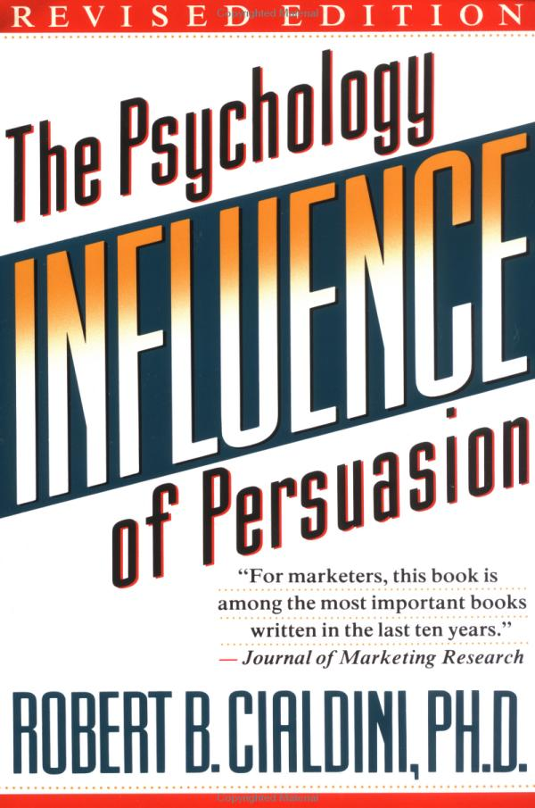


Slide 12

Daniel Pink
Autonomy
Mastery
Purpose
SDT
Autonomy
Competence
Relatedness
Notes:
What people WANT

Slide 13
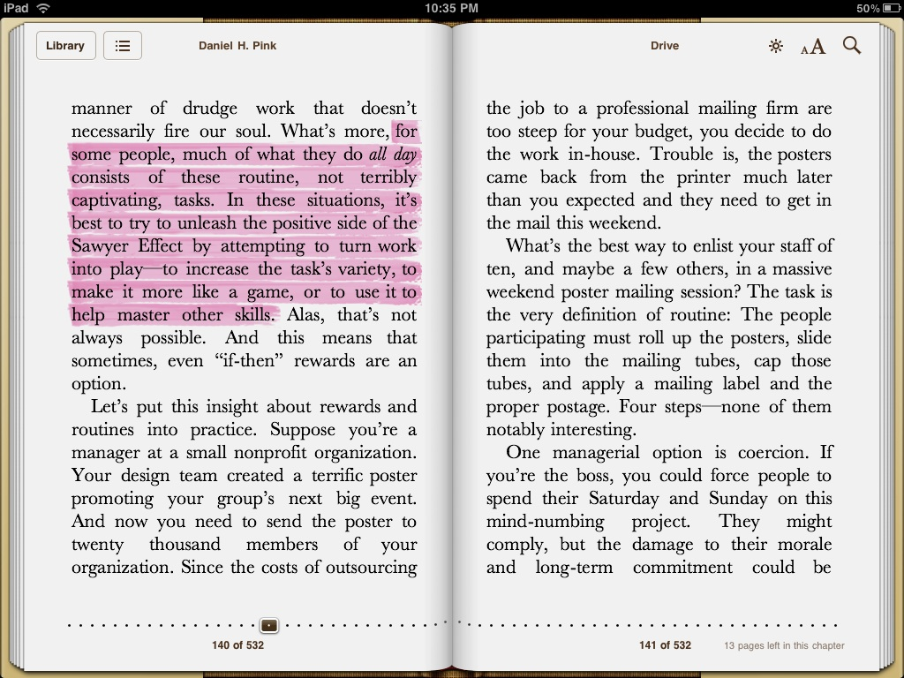
Notes:
People climb mt Everest. Their perspective is different

Slide 14
To apply gamification, you have to become a game designer, to become a games designer you have to apply design thinking.
Focus on users’ experiences, especially their emotional ones
Focus on fun and positive feedback loops
Notes:
We over think things… Its all about being MORE HUMAN

Slide 15
Games
Autonomy
Mastery
Purpose
Competence
Relatedness
Feedback
Notes:
Come traits of games and what they do.

Slide 16
Gamification:
“The process of game-thinking and game mechanics to engage users and solve problems”
-Gabe Zichermann
Notes:
Let’s introduce gamification
The premises behind it, behavioral economics and customer loyalty.

Slide 17
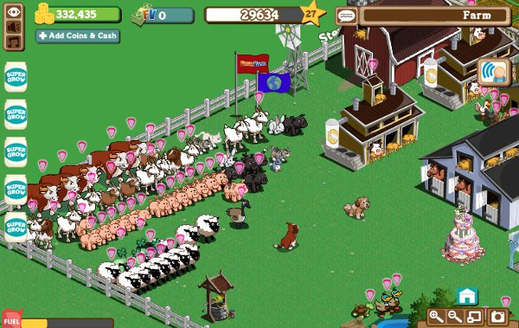
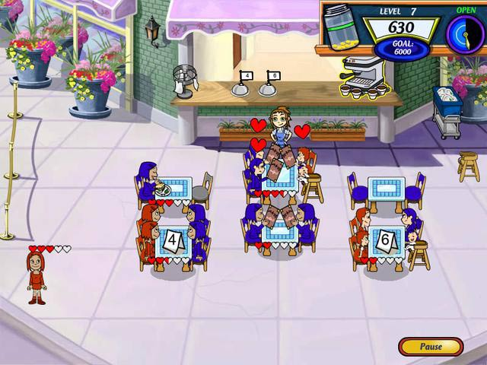
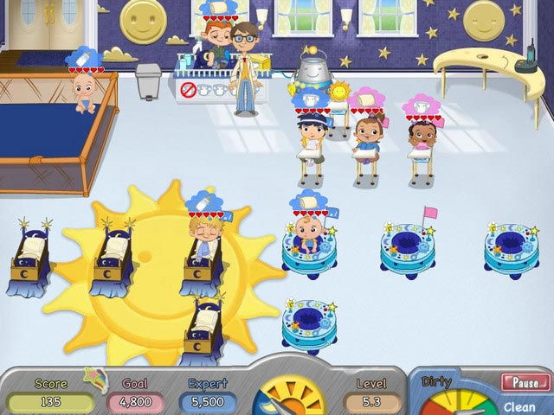
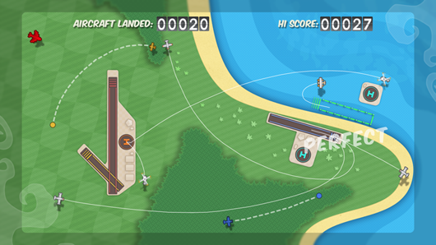
Really?
Notes:
2010

Slide 18
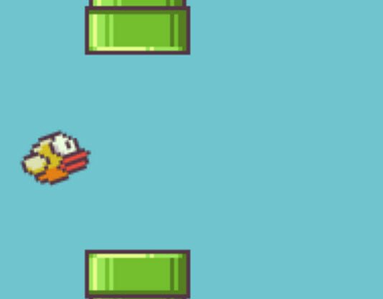
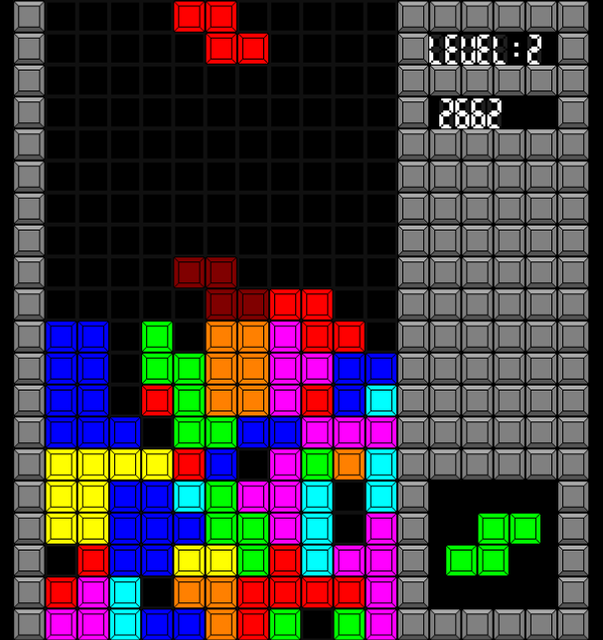
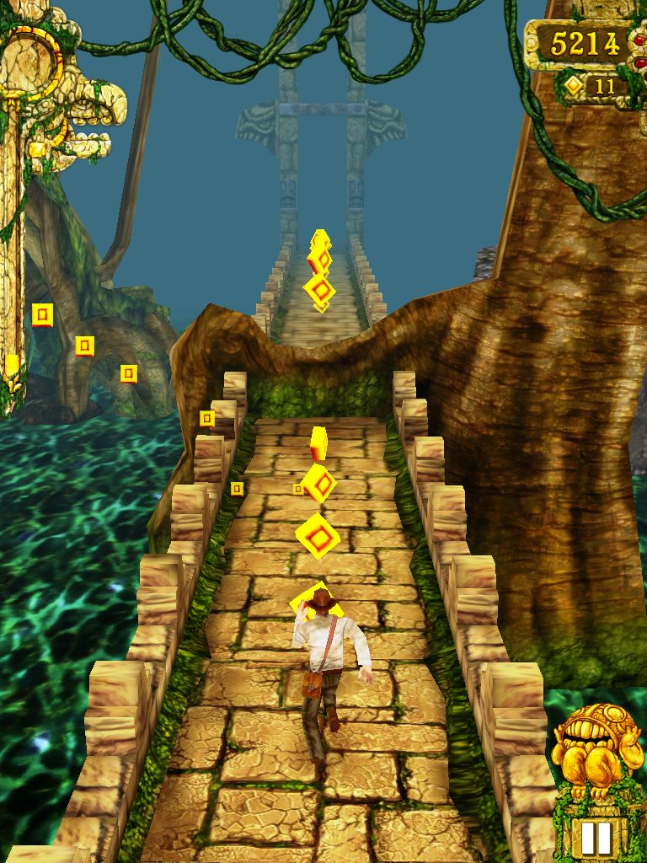
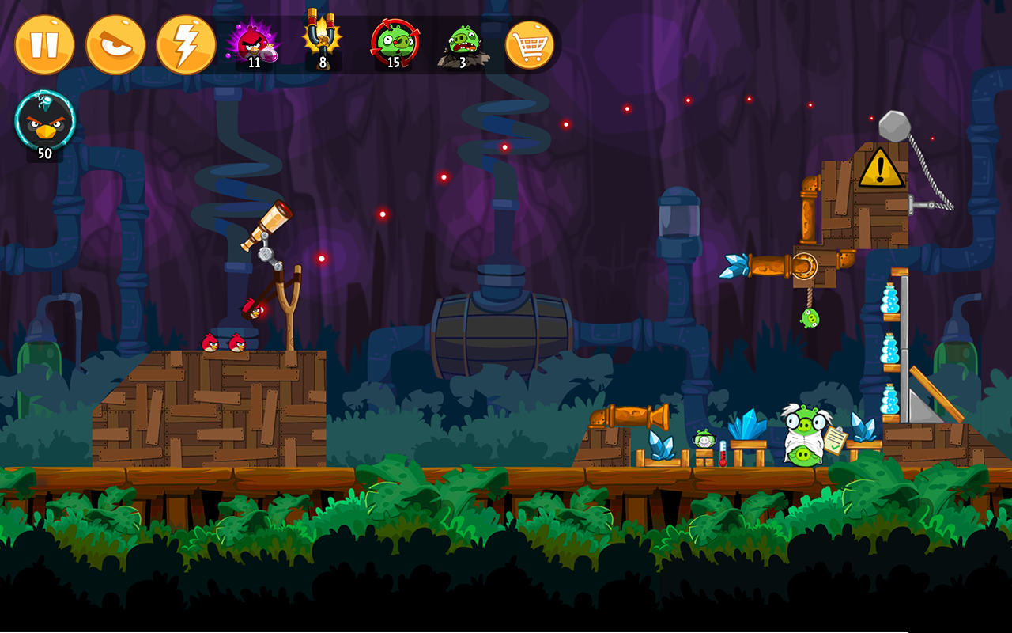
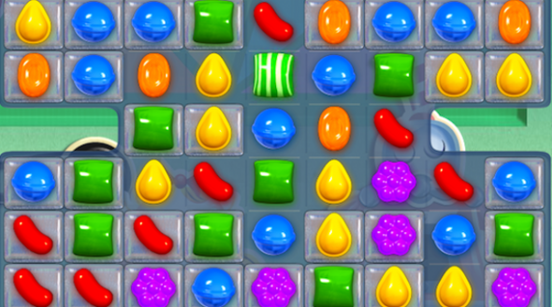
Notes:
2015

Slide 19
“It is the mechanics of a game-
not theme-that make it fun”
Notes:
Why did they work… dopamine

Slide 20
People avoid pain,
but they gravitate towards pleasure
Notes:
Drugs.

Slide 21
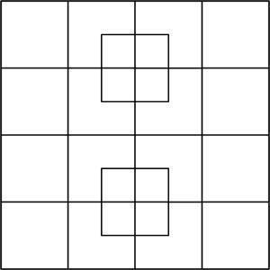
Notes:
How many squares do you see?

Slide 22
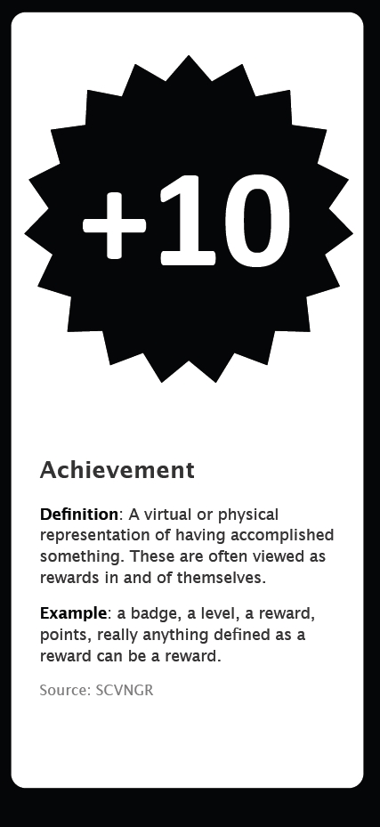
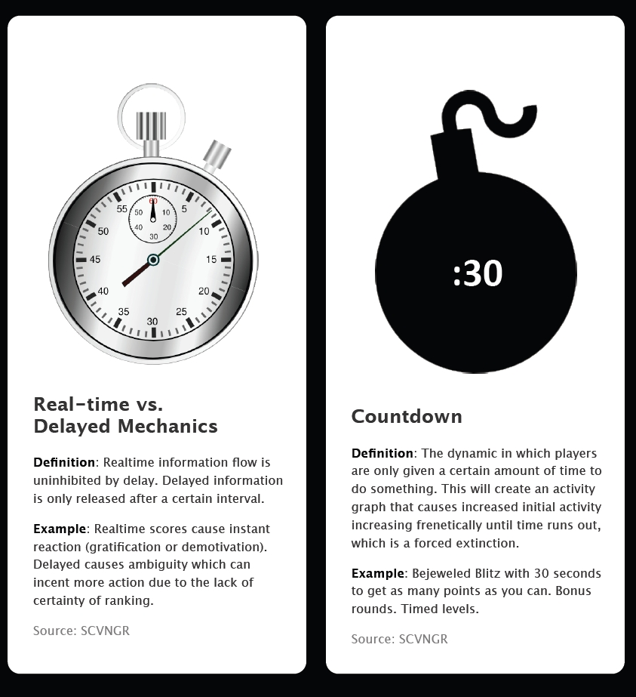
This study guide was prepared by @EricJFernandez to help out anyone trying to memorize game mechanics.
It is completely free to share, remix, and reuse as long as you respect any original copyrights. All images except logos are royalty free.

Slide 23
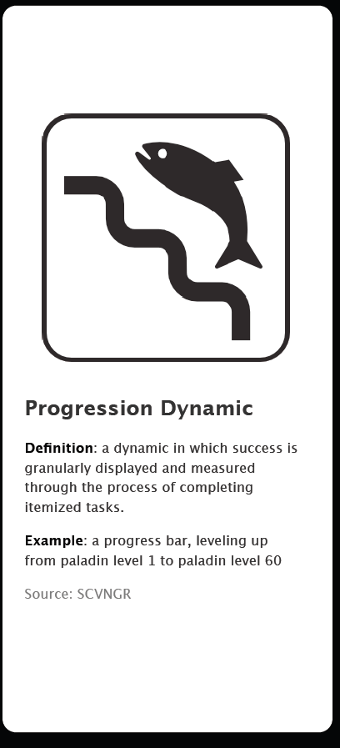
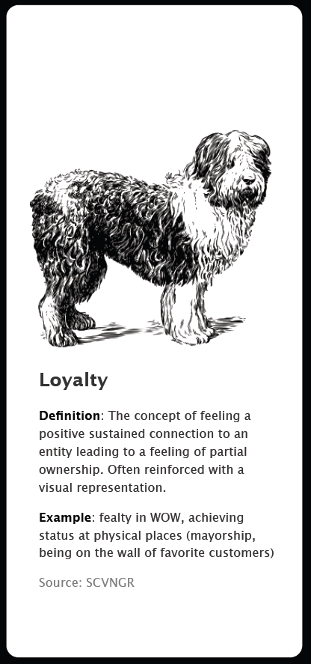
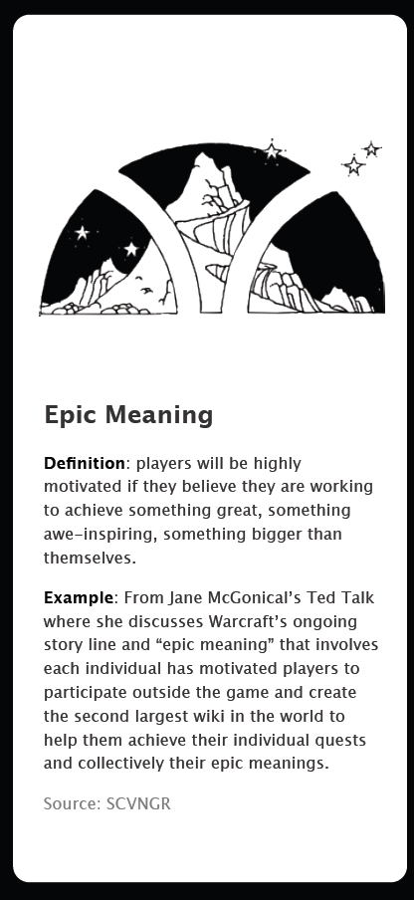
This study guide was prepared by @EricJFernandez to help out anyone trying to memorize game mechanics.
It is completely free to share, remix, and reuse as long as you respect any original copyrights. All images except logos are royalty free.

Slide 24
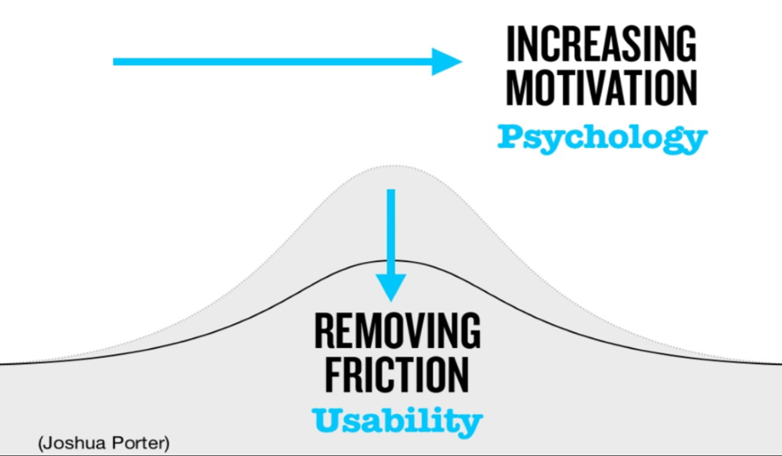
Make it fun, make it easy
Notes:
In organizations and life in general

Slide 25

Notes:
Focus on experience, focus on engagement

Slide 26
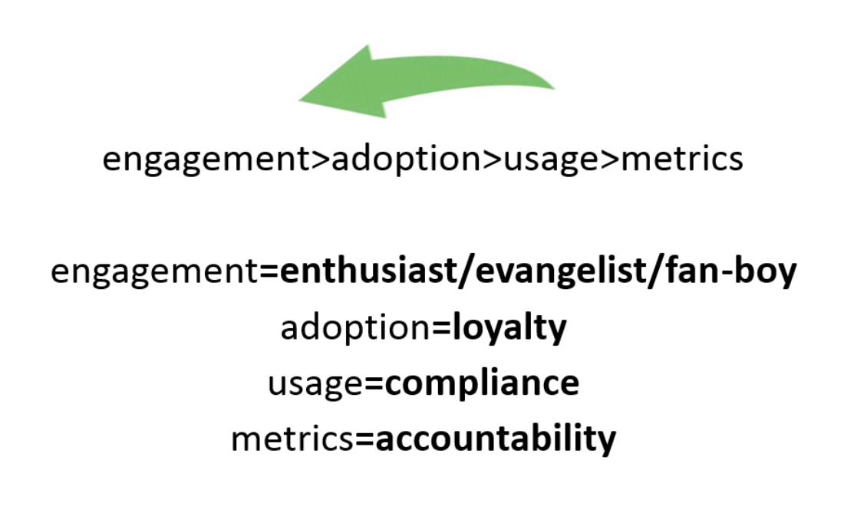

Slide 27
“If it can be measured
it can be Gamified”
Notes:
If it can be measured it can be gamified

Slide 28
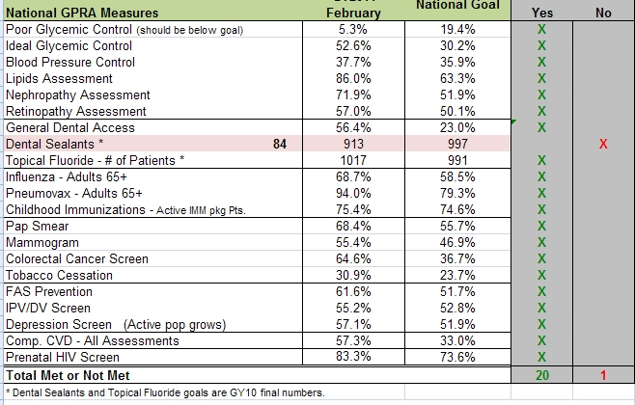
Notes:
People excellerate

Slide 29
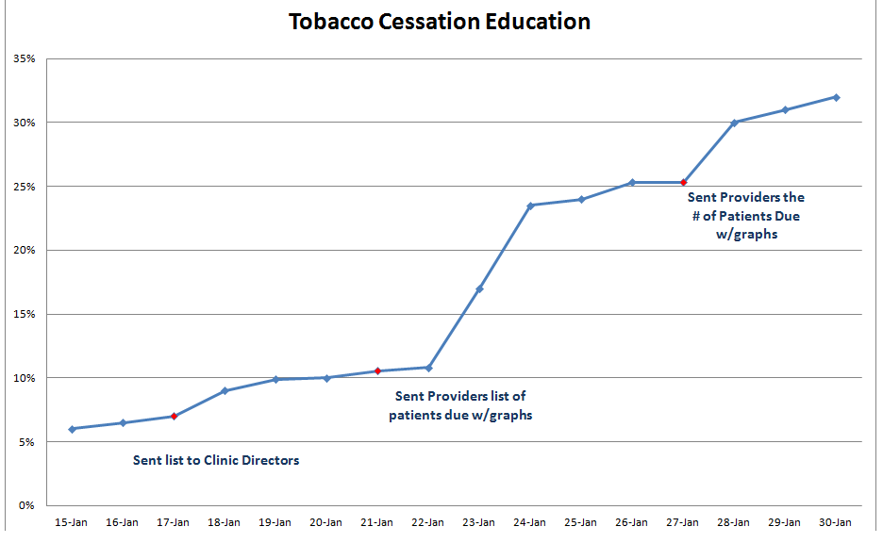
Notes:
met it in 15 days

Slide 30
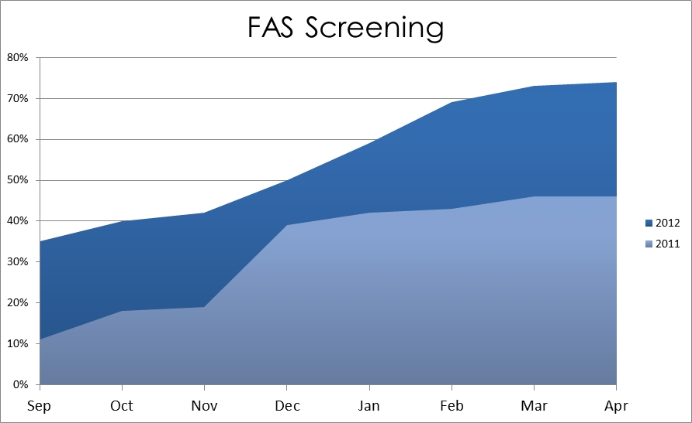
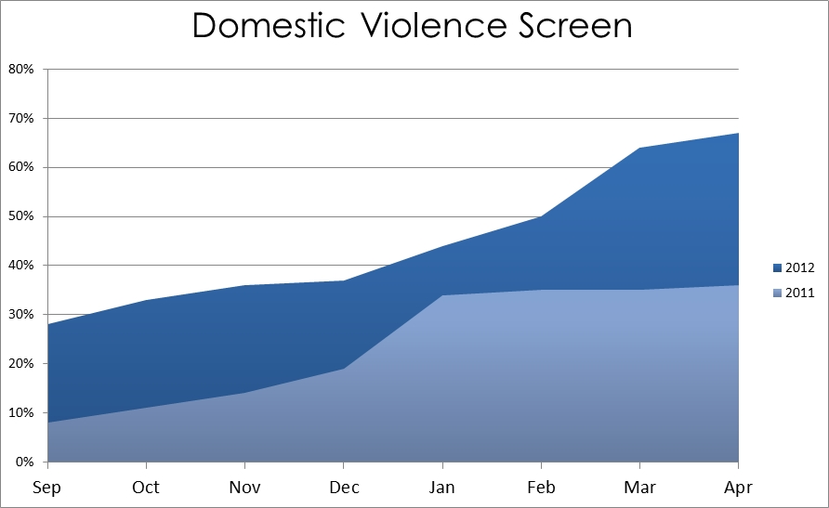
Notes:
CEO’s liked it.

Slide 31
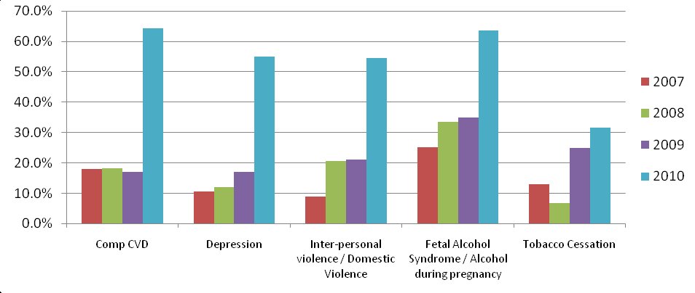
Reminders have been identified as a leverage point in clinical information systems (CIS) and can help your providers increase screening rates.
Identifying HIV/STI Screening Opportunities to Improve Nationally Reported Screening Rates using EHR
IHS Primary Care Provider, Volume 36 #4 p.80
Notes:
Met all their measures for the first time.

Slide 32
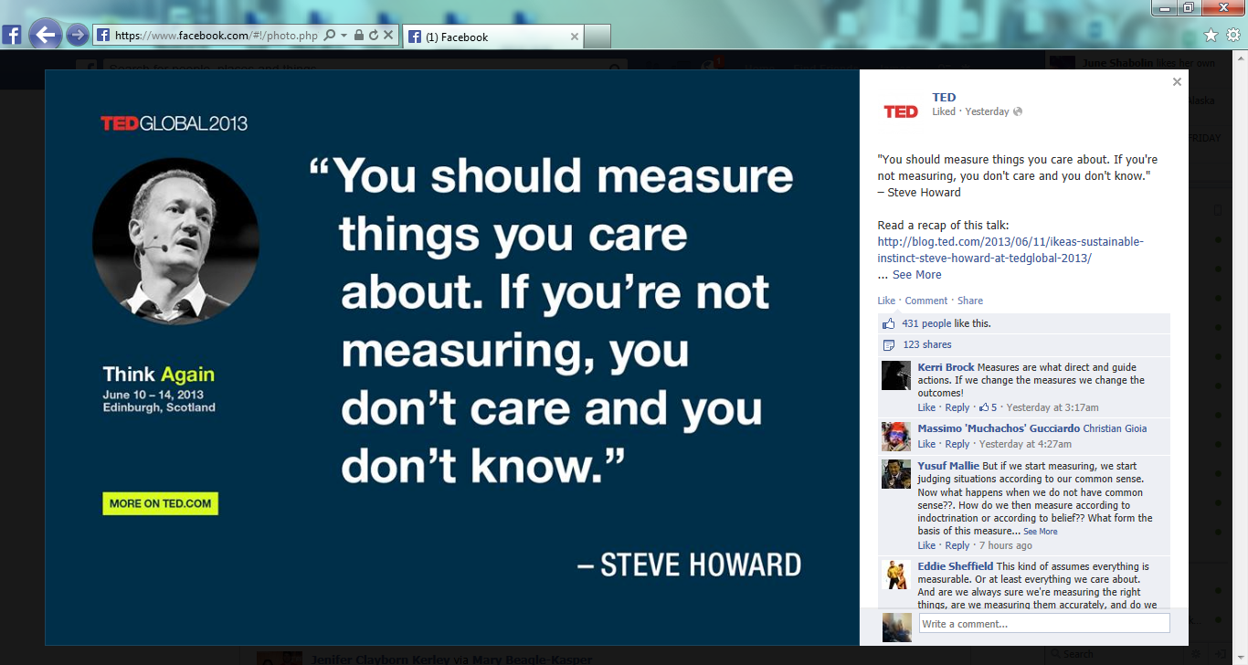

Slide 33
What does your heat map look like?
What parts of your website are working?
What are people doing after hitting various landing pages?
What social posts do they like and share?
Which ones do they dislike and ignore?

Slide 34
What Actions do you want people to take?
How are you going to measure them?
How are you going to reward them?
(more on this later)

Slide 35
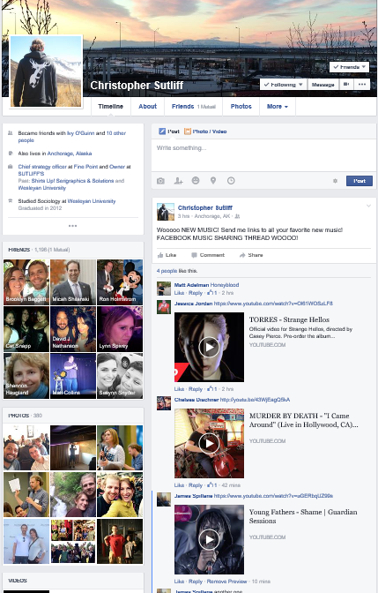
Notes:
Example of sharing, connection, crowd sourcing… user driven content, social equity!

Slide 36
Conversations are two way
Notes:
It is all about being ‘more human’ This is what games bring to the table! We will take one tool, feedback from a larger tool, gamification and talk about making it breath.

Slide 37
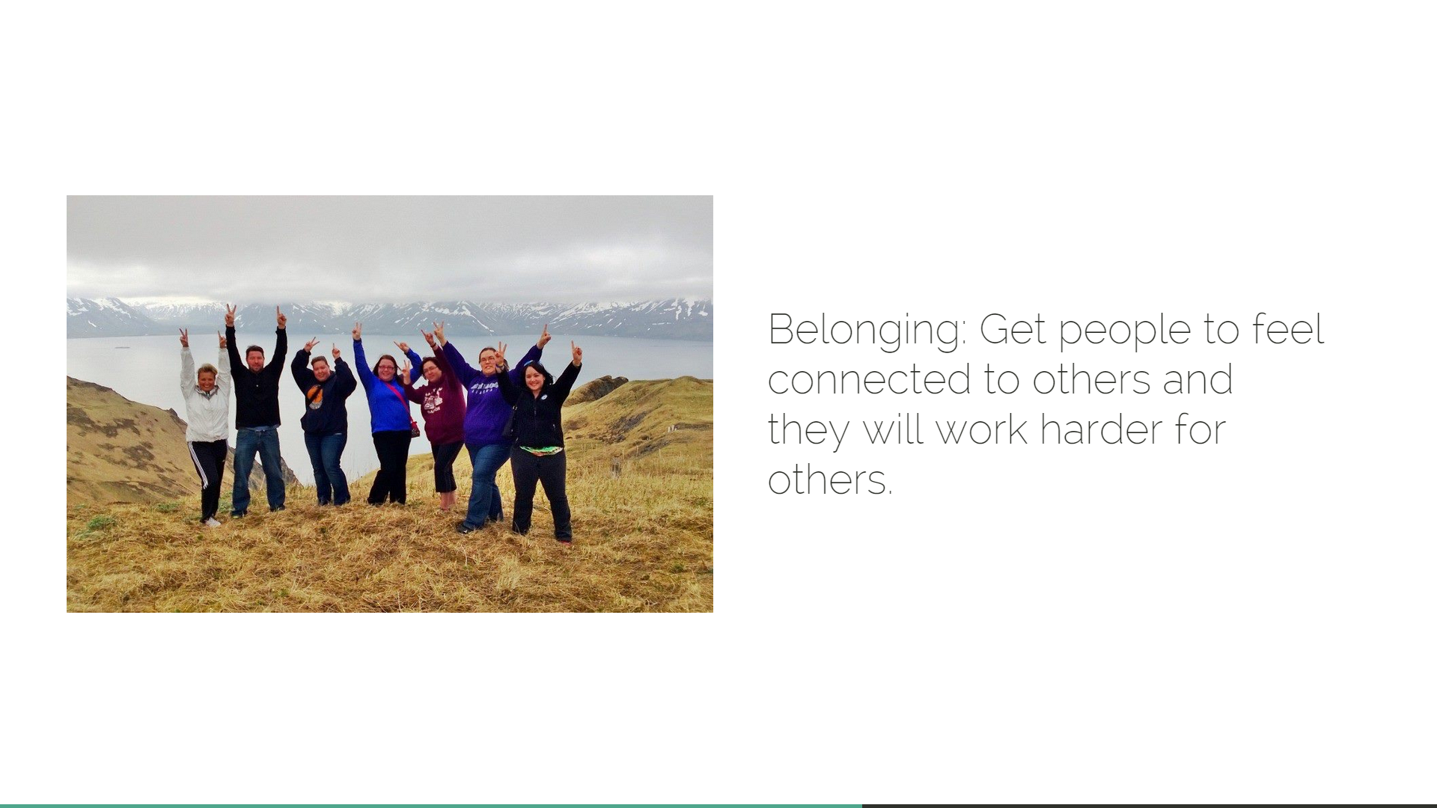

Slide 38
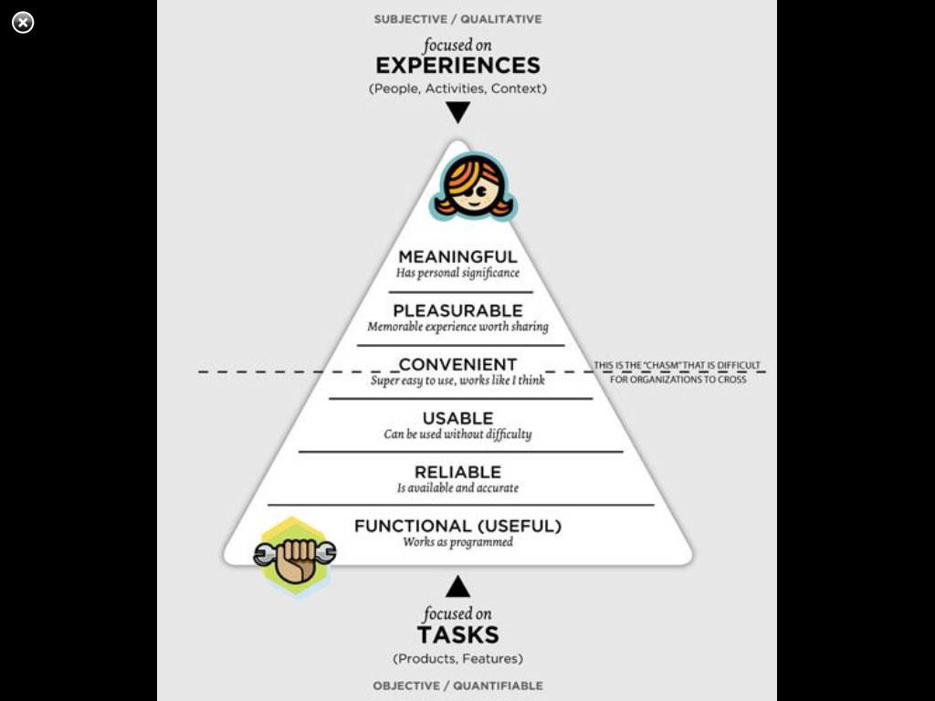

Slide 39
