Slide 1
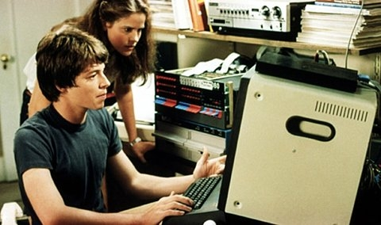
Leveraging Knowledge & Technology
James SPILLANE
Notes:
Bio (side note, I am not original, this whole presentation is full of hyperlinks and sources/design)
James Spillane…
Come from a small place called Friday Harbor Washington
spent about ten years over in Europe working for the DoD, came back,
lost, met my wife and moved to Kodiak.
Dental office manager, started to learn about clinical information systems and how much they can change a practice
KANA-GPRA 21 measures
Work for APIA… involved with many different organizations in alaska. Love it…

Slide 2

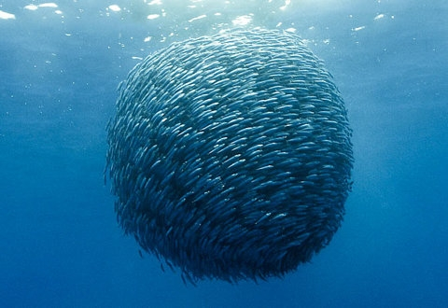
5 Stages of EHR
Independent care
Connected care
Coordinated care
Integrated care
Accountable care
Notes:
Tip of the iceberg, soon we will be a well organized group
Independent care., is where individuals or separate organizations provide much of the patient care.
Connected care., organizations begin to share enough, referrals
Coordinated care. where enough patient data is connected, [so that] it will allow multiple organizations to coordinate their care between each other through case tracking and management for simple tasks, such as identifying health risks. “This is the first maturity level where [patients feel] they aren’t leading their care team but are the center of their care team,” he said.
Integrated care. “multiple organizations share data and resources between each other, almost as fluidly as if they were a single organization without boundaries patients feel like they have control over their health.
Accountable care. which is where there is "such a high level of patient collaboration, that groups of firms become accountable for outcomes and costs together as a team."

Slide 3
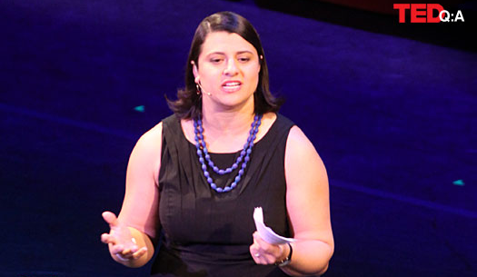
“A radical transformation of the electronic medical record from a static repository of diagnostic information to a health promotion tool… in the private sector when you squeeze that kind of additional value out of a fixed investment its called a billion dollar company, but in my world it’s called reduced obesity and diabetes…”
Rebecca Onie
Apr 2012 • TEDMED 2012

Slide 4
Information will no longer be pushed but rather pulled
Notes:
We are currently used to pushing information out, think about it? All the reports we have, all the accountability, funding, etc. click here, click there.. Go to this box, go to that box and at the end of the year, or quarter we are going to come back and tell you how bad you are doing. We are asking our “users” to jump through too many hoops, first, they are worried about their patients health, second they are worried about other aspects such as litigation, adverse effects, exhaustion. They don’t care about GPRA.

Slide 5
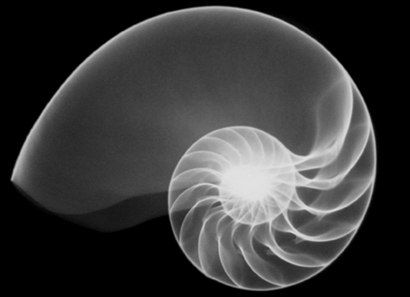
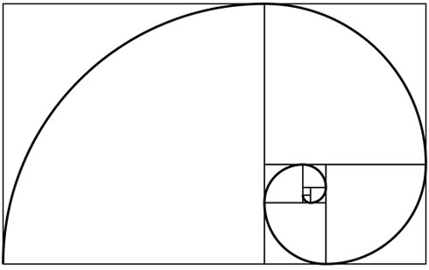
DESIGN
Notes:
Thoughts on Design
Are there humans involved in anything you do? Then you need to design around them.
Earth has been around 4.5 billion years, humans have been around for about 2.2 million years
Nature is full of beautiful, meaning full design that has evolved of many years… we are design, you are a designer.
What does all this mean?
Design around the nurse, the care team, the provider, design around the front desk, ask questions, get involved, observe and test.
things that are common need to become effortless, seamless, non visible.

Slide 6
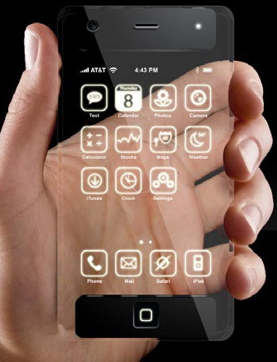
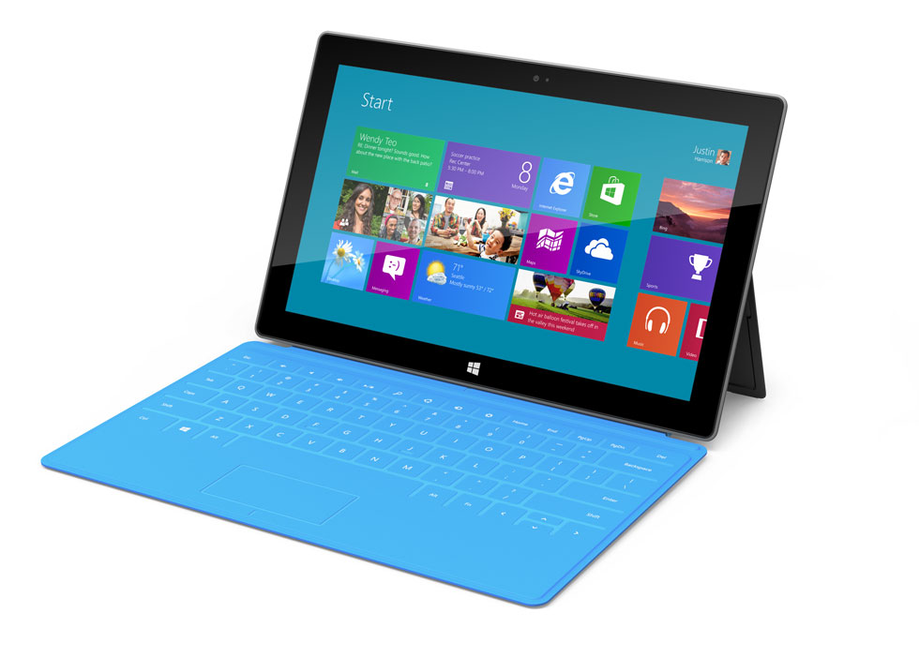
GREAT DESIGN= Adoption
Notes:
Back to the question: “are there humans involved in anything you do?”
what do people adopt? Big business understands that adoption comes from design and spends a lot of resource tying to make this happen.
Design around the nurse, the care team, the provider, design around the front desk, ask questions, get involved, observe and test.
things that are common need to become effortless, seamless, non visible.

Slide 7
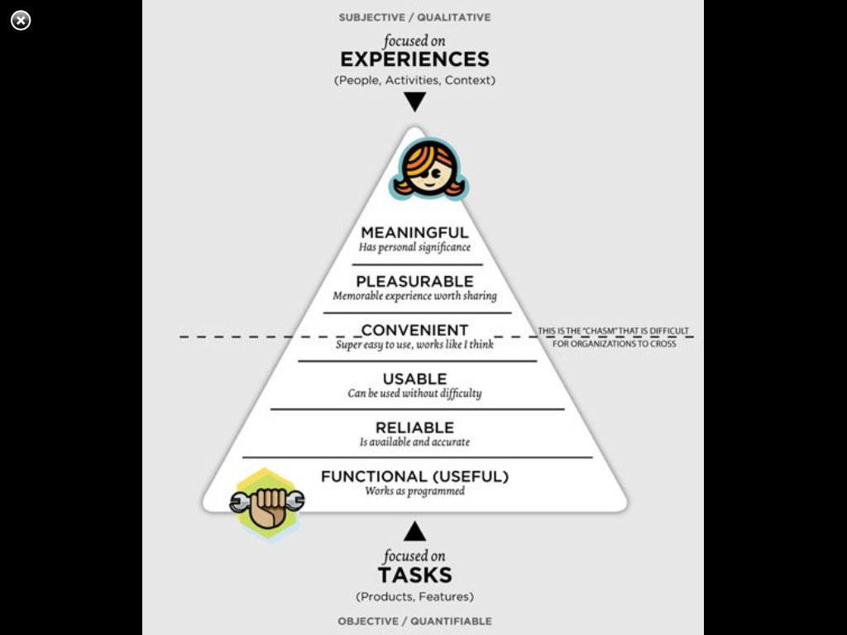
HIERARCHY
Notes:
Meaningful, we have that! HEALTH, it is the same as PURPOSE in what drives us
Pleasurable and convenient is lacking…

Slide 8
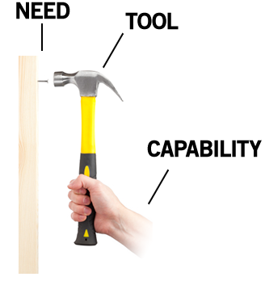
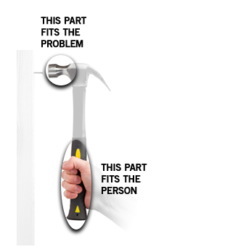
DESIGN BASICS
Notes:
Another way to look at it
NEED: health
TOOL: EHR and CIS
CAPABILITY: docs, users (all of which have no problems with their iPhones)
So of the hammer or tool is our CIS, we need to make it fit the person! We need to design a better CIS, we need to design for humans.

Slide 9
DESIGN PROBLEMS
Notes:
We have some how lost our way, we have the need, we have the tools and capability, but there is a disconnect, we need to match the tools to the capability.

Slide 10
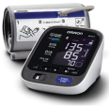
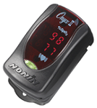

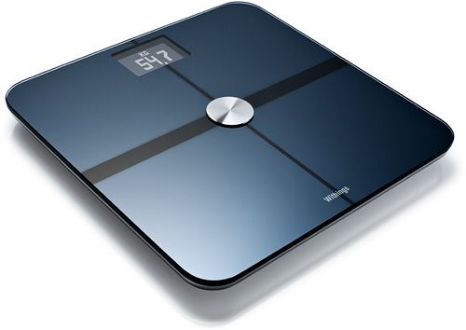

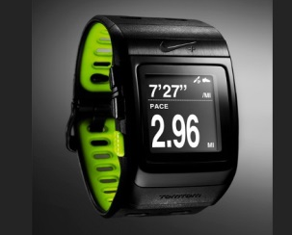
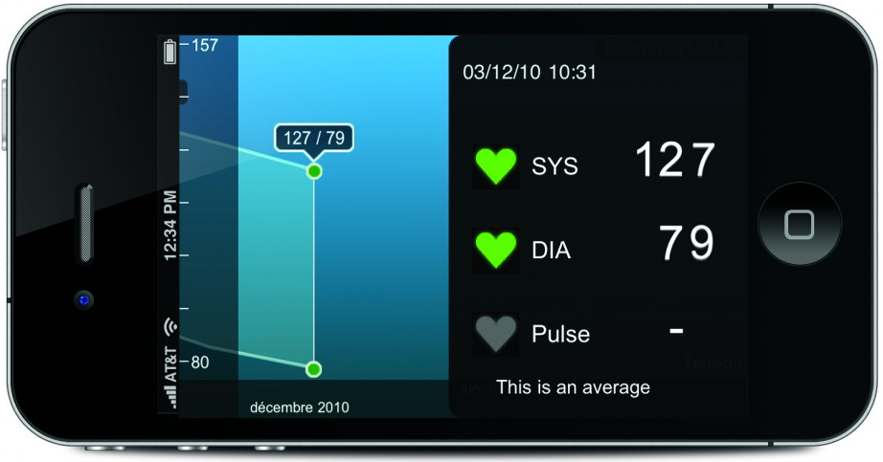
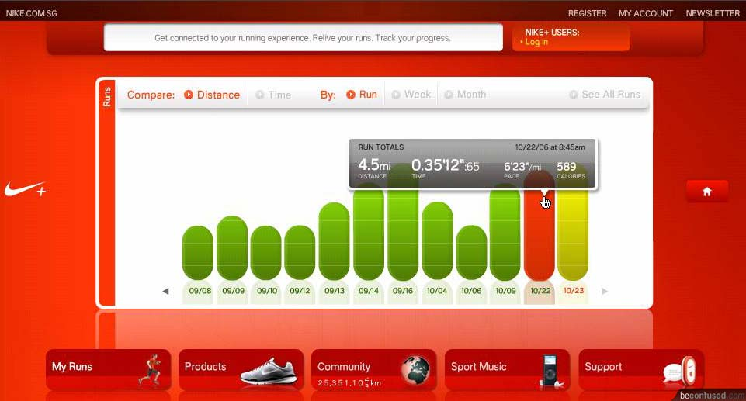
SEAMLESS
Notes:
So let’s look at where we are going, all of these devices are pretty effortless, you take your BP, check your blood sugars, put a pedometer in our pocket, go for a run, all this information is PUSHED to your phone, it syncs up wirelessly, you don’t to sit down and enter all the vitals, enter the all miles and time of your run, calculate the calories you burned etc… (side note: it also very gamified)
My question is: why doesn’t our CIS already do this? And since it doesn’t we need to start thinking this way.

Slide 11
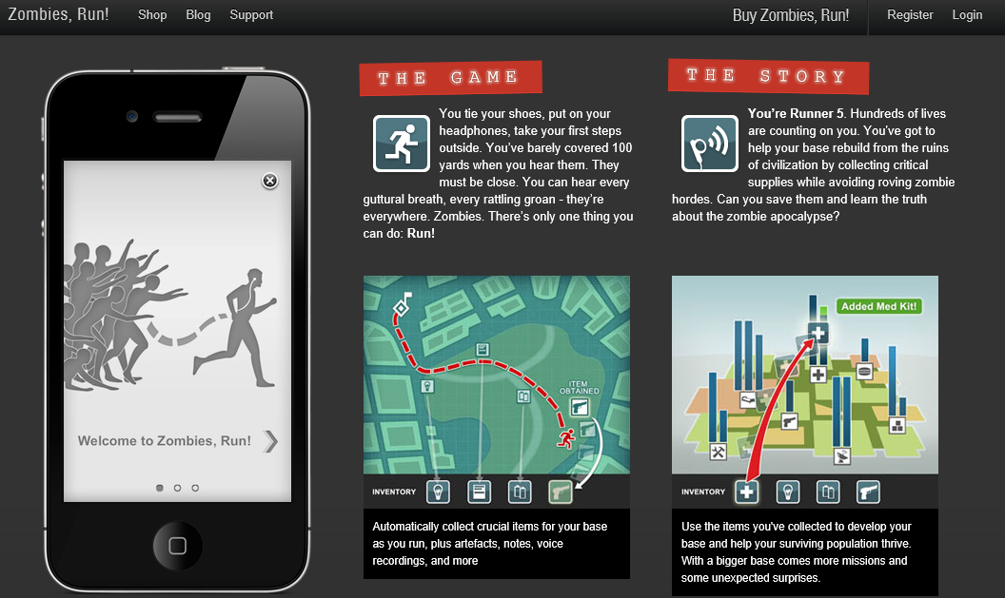
FUN
Notes:
Here is one of my favorites, remember things can be fun, it is a matter of perspective, but I will talk about this later in my game dynamics lecture.

Slide 12
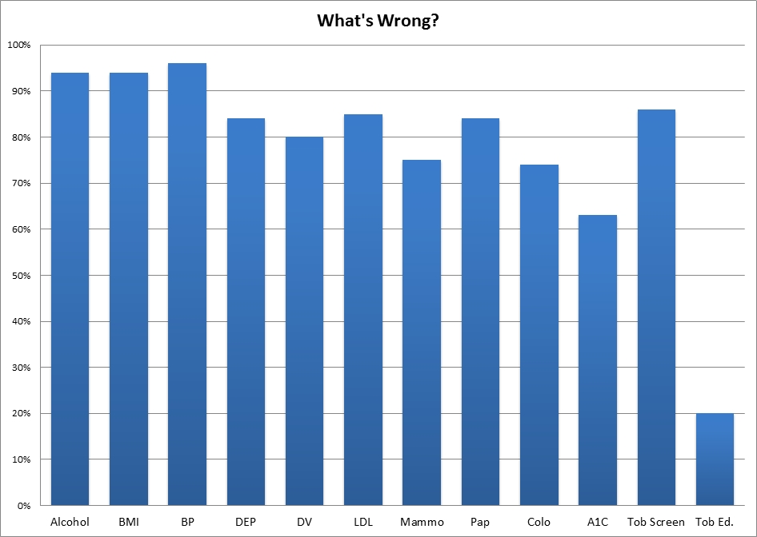
DIAGNOSIS
Notes:
First we have to know where we are? What is wrong what can we design better, a lot of times it comes straight from the numbers (what do you such at?) while other times it comes from the relationships you have built with your team of providers (nurse stations and water coolers) this is one of the reasons why IPC pushes for the pod design, you can quickly look over your shoulder and say, “hey skip, the order menu reads funny, could you put the HIV test over here under prenatal that way we know to order them”
You have to know your system!

Slide 13
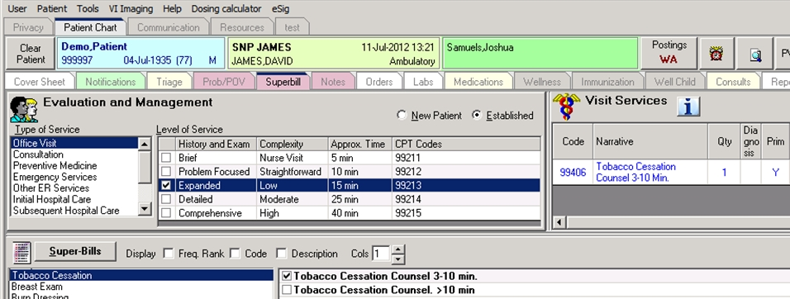
SOLUTIONS

Slide 14
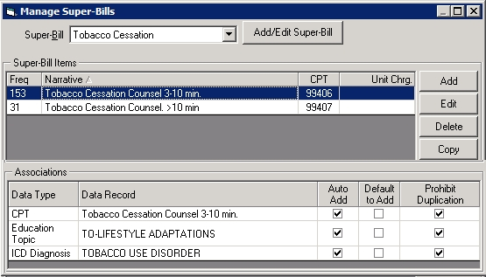
SOLUTIONS

Slide 15
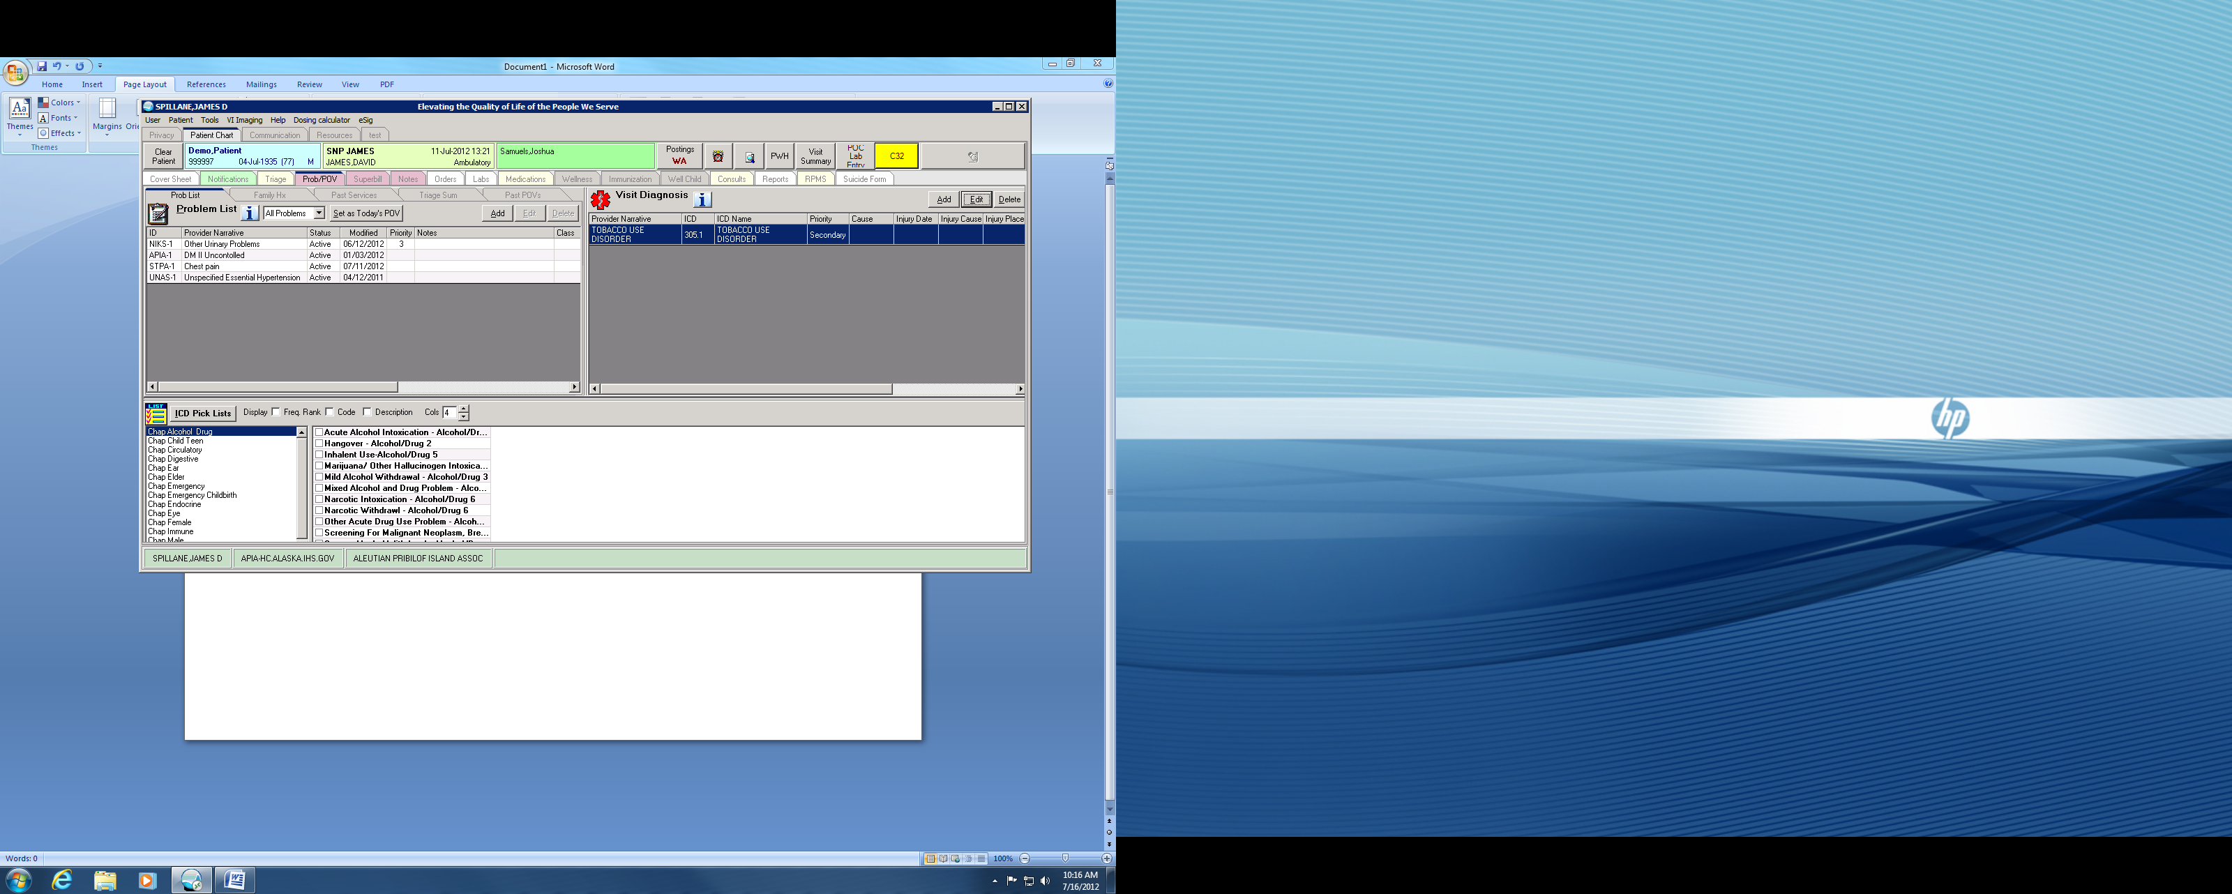
SOLUTIONS

Slide 16
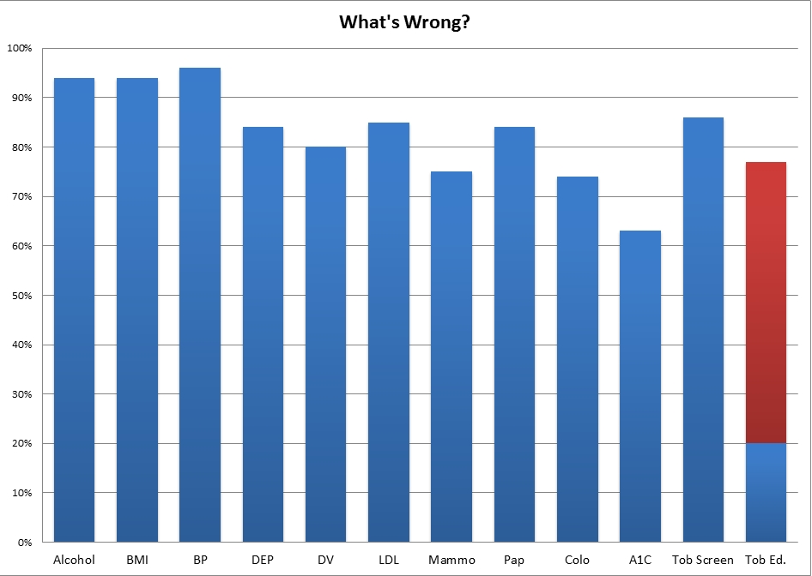
CHANGE

Slide 17
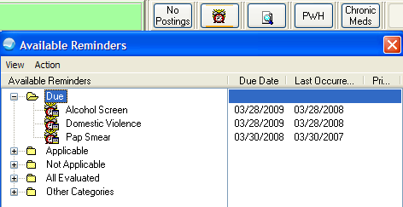
Clinical Reminders:
Notes:
Clinical reminders is probably one of the best examples of good design, it providers instant feedback in an almost gamified way. You see the information you need in a relevant convenient matter, but better yet, it doesn’t make your jump through the hoops to enter the information, basically it is one stop shopping in the one place everyone needs to go, the check out counter=your clinical notes tab.
Reminders can tie into almost anything, consults, education topics, labs, medications, adverse reactions, clinical warnings it is the perfect mix of push and pull of data, gamification, feedback, it is almost perfect “design” the only way it could get better is if it provided real time feedback on your completion ratio.

Slide 18
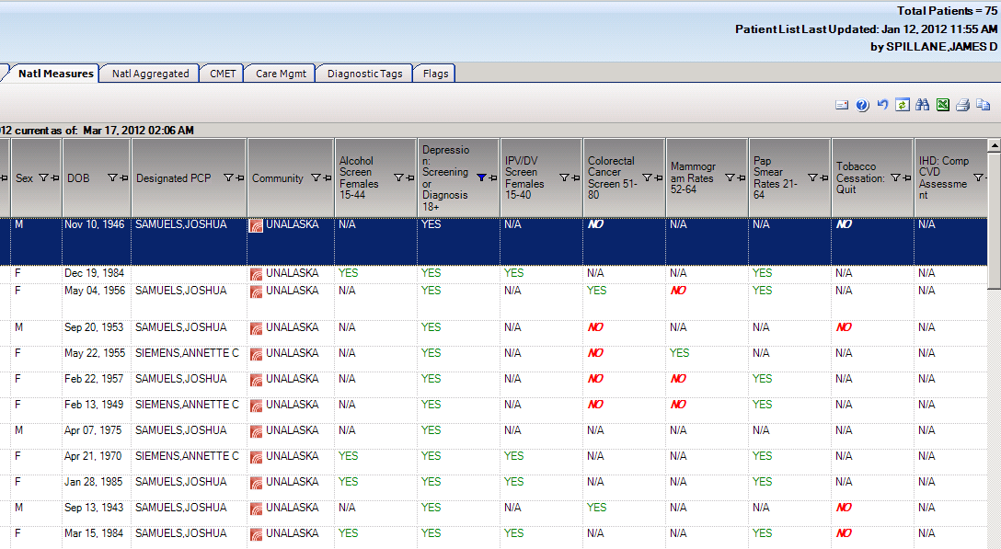
iCare:

Slide 19
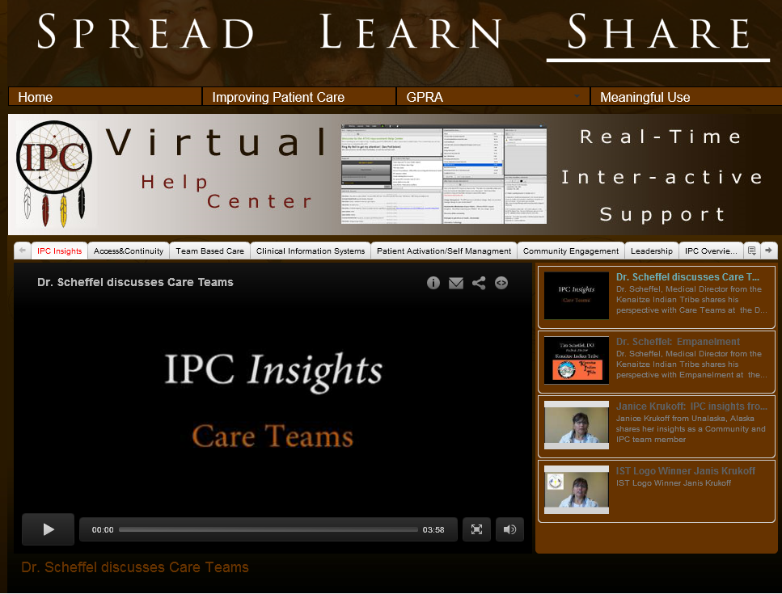
SHARE IT

Slide 20
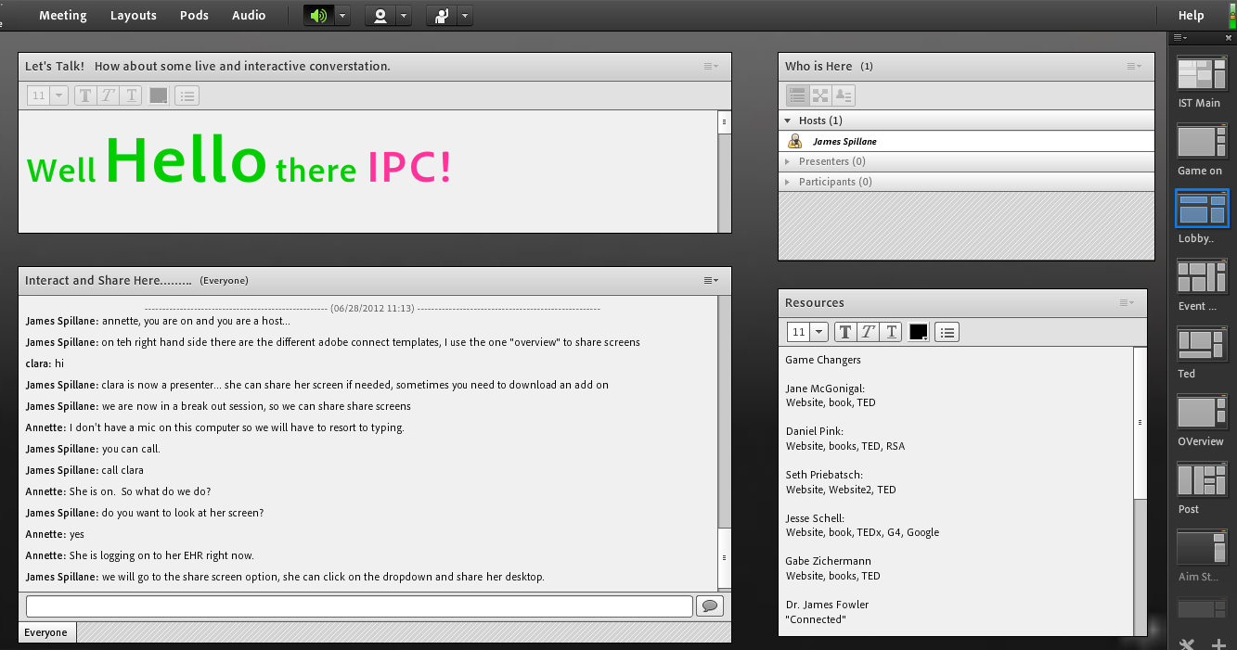
SUPPORT IT

Slide 21
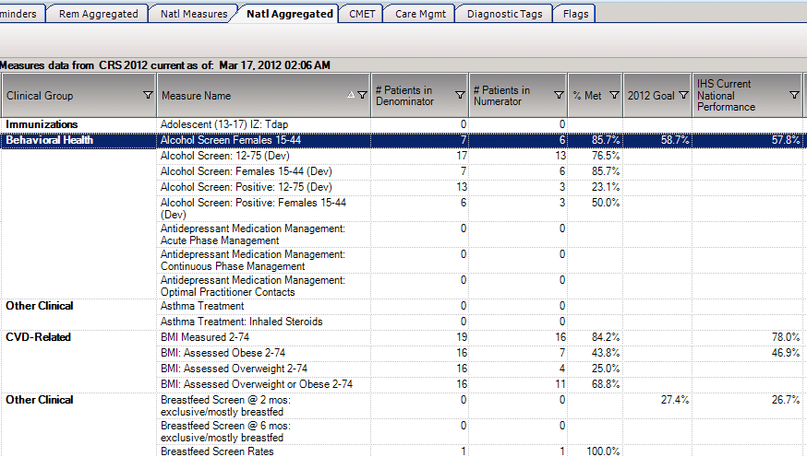
iCare:

Slide 22
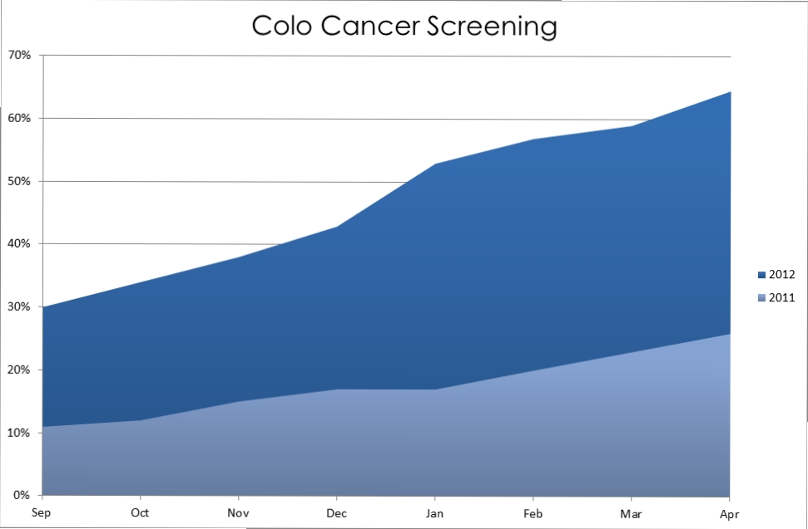
FEEDBACK/STORIES
Notes:
I can’t express enough how fundamental feed back is, give them something pretty, something that visually tells a story, all stories have a good guy and a bad guy, a goal, a purpose. Give and impact story (recently we lost a patient who had ten visits where they were due for a colorectal screen, we never caught it but cancer did, he recently passed) we have since been steady increasing our colorectal screening rates (relate these numbers to people, a population of 10,000 patients du

Slide 23
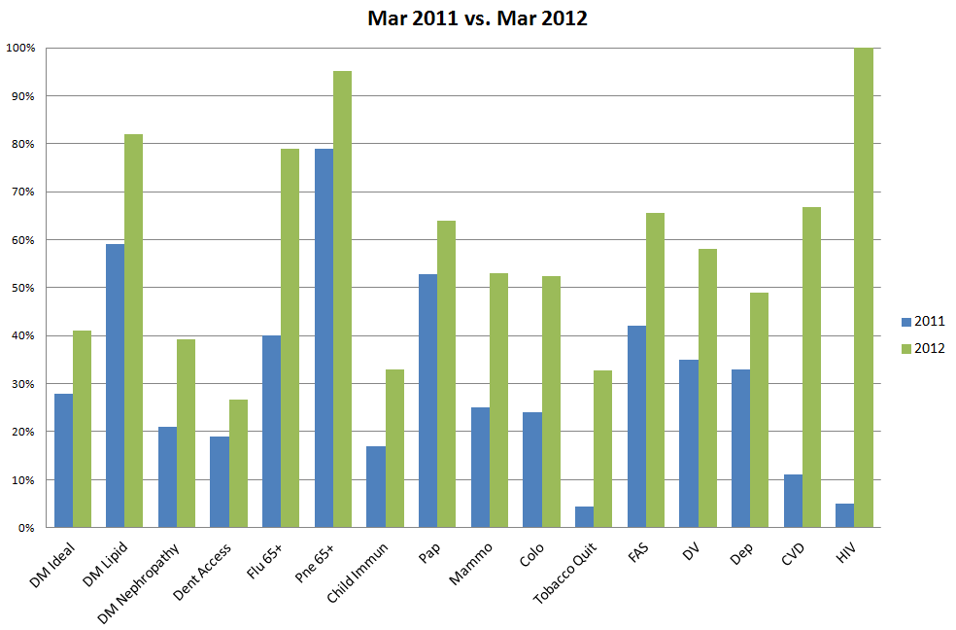
RESULTS/GPRA

Slide 24
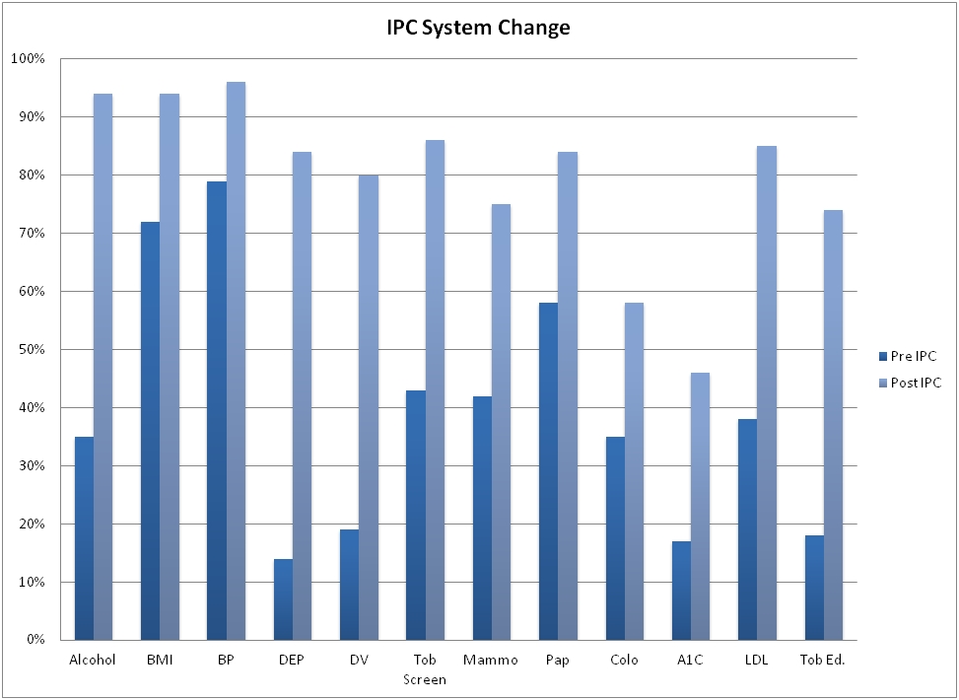
RESULTS/IPC

Slide 25




SOCIAL
twitter.com/jamesspillaneis
facebook.com/JamesSpillaneIS
jamesspillaneis.blogspot.com
linkedin.com/james-spillane

